Slide 1


FLEXBOX & GRID
ONE GIANT LEAP FOR WEB LAYOUT
Notes:
https://philipwalton.github.io/solved-by-flexbox/
https://philipwalton.github.io/solved-by-flexbox/demos/grids/

Slide 2


AGENDA
FLEXBOX
AXES & SIZE
DIRECTION
FLEXIBILITY
ORDER
ALIGNMENT
CSS GRID
Notes:
MAIN COMPONENTS OF FLEXBOX
Flexbox is a whole unit rather than just a single property. It combines a number of properties that we now consider in more detail.

Slide 3
introduction

Slide 4
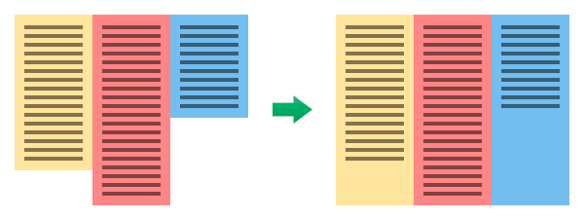
CSS PROBLEMS
<header>
<nav>
<article>
<aside>
<footer>
Notes:
1
CSS PROBLEMS
Simple things like blocks of the same height, the vertical alignment of the blocks, filling available space, etc., were carried out difficult.
So the question arises: "Why we have no properties that would carry these things quickly and simply?"

Slide 5
CSS PROBLEMS
Notes:
2
CSS PROBLEMS
Simple things like blocks of the same height, the vertical alignment of the blocks, filling available space, etc., were carried out difficult.
So the question arises: "Why we have no properties that would carry these things quickly and simply?"

Slide 6
CSS PROBLEMS
Notes:
3
CSS PROBLEMS
Simple things like blocks of the same height, the vertical alignment of the blocks, filling available space, etc., were carried out difficult.
So the question arises: "Why we have no properties that would carry these things quickly and simply?"

Slide 7
CSS PROBLEMS
Notes:
4
CSS PROBLEMS
Simple things like blocks of the same height, the vertical alignment of the blocks, filling available space, etc., were carried out difficult.
So the question arises: "Why we have no properties that would carry these things quickly and simply?"

Slide 8
CSS PROBLEMS
Notes:
5
CSS PROBLEMS
Simple things like blocks of the same height, the vertical alignment of the blocks, filling available space, etc., were carried out difficult.
So the question arises: "Why we have no properties that would carry these things quickly and simply?"

Slide 9
GOODBYE FLOATS AND CLEARFIXES
HELLO FLEXBOX.
Notes:
HELLO FLEXBOX
Finally we have got the the solution of all these problems! This is CSS3 Flexbox! The Flexbox Layout (Flexible Box) module is meant to help us lay out elements and modules within websites and applications.
Flexible box layout (or flexbox) is a new box model optimized for UI layout. It gives us a new layout mode that will mitigate many of the shortcomings of current CSS layout.
What this means to you, as a developer, nay, as a Layout Architect™ is:
Floats? Where we're going, we don't need floats.
Layouts that were challenging before are more sensible.
We can create true flexible layouts, and the browser will do the calculations for us.

Slide 10
Available
space
even when we don’t know what that will be
Notes:
AVAILABLE SPACE
TIPS
To control the distribution of space between the elements even dynamic.
The main idea of flex-layout of giving the container the ability to modify elements to better fill the space.
The Flexbox Layout (Flexible Box) module (currently a W3C Last Call Working Draft) aims at providing a more efficient way to lay out, align and distribute space among items in a container, even when their size is unknown and/or dynamic (thus the word "flex").
The main idea behind the flex layout is to give the container the ability to alter its items' width/height (and order) to best fill the available space (mostly to accommodate to all kind of display devices and screen sizes). A flex container expands items to fill available free space, or shrinks them to prevent overflow.

Slide 11
align ment
both horizontally and vertically
Notes:
BOTH HORIZONTALLY AND VERTICALLY ALIGNMENT
Also, Flexbox is good in control the alignment of elements on several axes: vertical and horizontal, the baseline of the text.
Most importantly, flexbox-layout does not depend on the direction of flow, unlike normal layouts (blocks are located vertically, and inline elements are located horizontally).
At the same time, as a normal layout is perfect for web pages, it lacks flexibility (no pun) to support large or complex applications (especially when it comes to change the screen orientation, resize, stretch, narrowing, etc.) .

Slide 12
ordre
display
Notes:
DISPLAY ORDER
Flexbox allows you to control the size of the order, and more. Elements location in html is not decisive. It can be changed in CSS. This is especially important for some aspects of the responsive layout.
You can set direction within containers. (Layout boxes in any direction. Flow directions can be up or down, left or right, display order can be reversed.). Many languages in the world use rtl (right-to-left), as opposed to the usual we ltr (left-to-right). Flexbox adapted for this purpose. It is the concept of begin and end, but not the right and left. So that, in browsers with rtl all elements will be automatically arranged in reverse order.

Slide 13
Concepts and Terminology

Slide 14
FLEXBOX CONTAINER AND ITEMS
To start work with flexbox, you need
to define flex container
Items in a flex container are, by default, flex items (even anonymous block boxes)
@supports (display: flex | inline-flex) {
.container {
display: flex | inline-flex;
} }
​
I am a flex item
Me too!
And me!
Notes:
1 level of nesting
Container with display:flex behaves like a block-level element itself, while display:inline-flex makes the container behaves like an inline element.
FLEXBOX CONTAINER
In order to designate the use of Flexbox, we need to create a container on which we will build. And the first thing we need to do - is to create the container and set the flex | inline flex in the display property.
Flexbox defines a set of CSS properties for a container (flex-container) and its children (flex-items).
Property: display: flex | inline-flex;
Applied to: parent flex container element.
Description: Specifies the flex-container (inline or block, depending on the selected value), flex-connect context for all of his direct descendants. Specifies the flex-container (inline or block, depending on the selected value), set flex-context for all of its direct descendants.
By default, Flexbox is a block element, but we also can make it inline.
CSS: display: other values | flex | inline-flex;
Note:
CSS columns do not work with flex-container
Example:
- To force an element to use the flexbox layout, we add the flexbox value to the display property.
#container {
display: flexbox;
}
- By default, a flexbox is a block level element; we can define an inline-level element like so:
#container {
display: inline-flexbox;
}

Slide 15
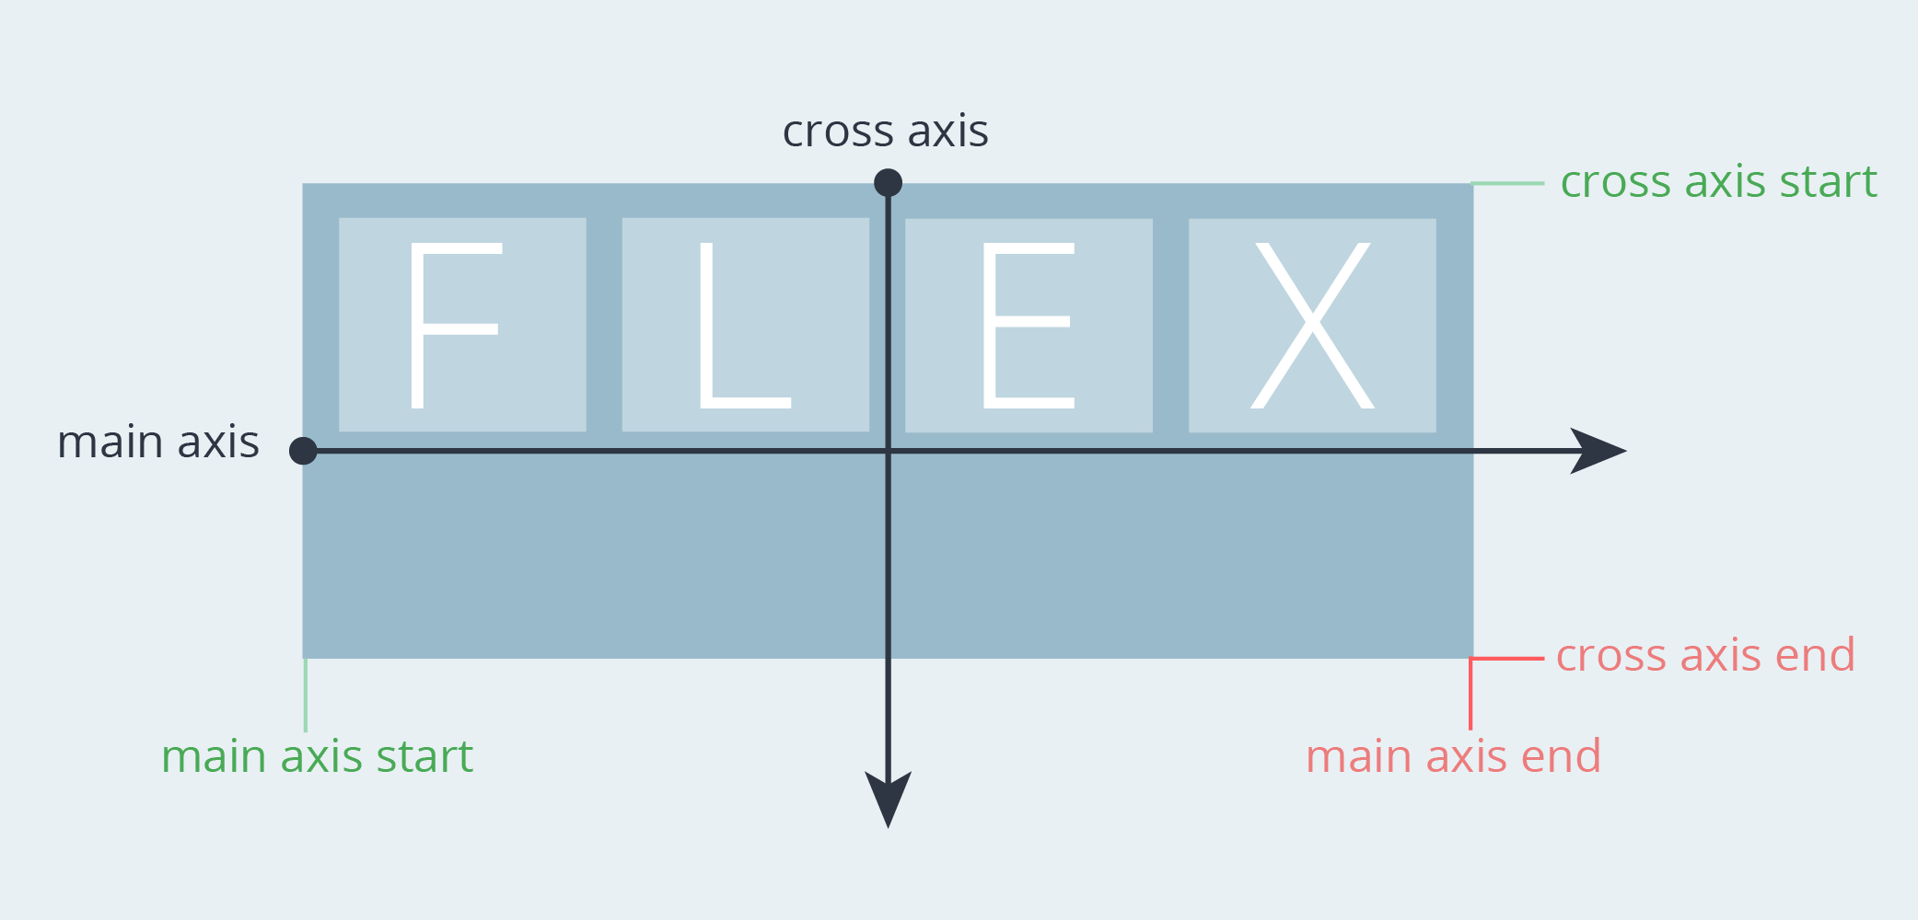
FLEX AXES
Notes:
Depending on the values of the Flexbox properties, flex items will be laid out inside a flex container following either the main axis or the cross axis.
The main axis of a flex container is the primary axis along which flex items are laid out. It extends in the main dimension.
The flex items are placed within the container starting on the main-start side and going toward the main-end side.
A flex item’s width or height, whichever is in the main dimension, is the item’s main size. The flex item’s main size property is either the width or height property, whichever is in the main dimension.
The axis perpendicular to the main axis is called the cross axis. It extends in the cross dimension.
The width or height of a flex item, whichever is in the cross dimension, is the item’s cross size. The cross size property is whichever of width or height that is in the cross dimension.
Flex lines (see next section below) are filled with items and placed into the container starting on the cross-start side of the flex container and going toward the cross-end side.
The 'flex-direction' property specifies how flex items are placed in the flex container, by setting the direction of the flex container's main axis. This determines the direction in which flex items are laid out in.
MAIN AXIS
main-axis The main axis of a flex container is the primary axis along which flex items are laid out. Beware, it is not necessarily horizontal; it depends on the flex-direction property (see below).
main-start | main-end - The flex items are placed within the container starting from main-start and going to main-end.
main size - A flex item's width or height, whichever is in the main dimension, is the item's main size. The flex item's main size property is either the ‘width’ or ‘height’ property, whichever is in the main dimension.
CROSS AXIS
cross axis - The axis perpendicular to the main axis is called the cross axis. Its direction depends on the main axis direction.
cross-start | cross-end - Flex lines are filled with items and placed into the container starting on the cross-start side of the flex container and going toward the cross-end side.
cross size - The width or height of a flex item, whichever is in the cross dimension, is the item's cross size. The cross size property is whichever of ‘width’ or ‘height’ that is in the cross dimension.
START & END
The main axis in ltr locale is placed left to right by default.
Cross axis in ltr locale is placed top down by default.

Slide 16
START & END DEPEND ON DIRECTION
.container { flex-direction: row; }
.container { flex-direction: column; }
cross start
main start
main start
main end
cross start
cross end
cross end
main end
Notes:
START & END
The main axis in ltr locale is placed left to right by default.
Cross axis in ltr locale is placed top down by default.

Slide 17
START & END DEPEND ON DIRECTION
.container { flex-direction: row-reverse; }
.container { flex-direction: column-reverse; }
cross start
main end
main end
main start
cross start
cross end
cross end
main start
Notes:
START & END
The main axis in ltr locale is placed left to right by default.
Cross axis in ltr locale is placed top down by default.

Slide 18
CONTAINER PROPERTIES

Slide 19
FLEX-DIRECTION AND LTR DIRECTION
CSS
//direction: ltr;
.container { flex-direction: row |
row-reverse |
column |
column-reverse
}
Notes:
flex-direction - specifies how flex items are placed in the flex container defining the main axis and the direction (normal or reversed).
FLEX DIRECTION
Property: flex-direction – the direction flex items are placed in the flex container
Applied to: parent flex container element.
Description: This establishes the main-axis, thus defining the direction flex items are placed in the flex container. Flexbox is (aside from optional wrapping) a single-direction layout concept. Think of flex items as primarily laying out either in horizontal rows or vertical columns.
CSS: flex-direction: row | row-reverse | column | column-reverse
Available values:
row (default): left to right in ltr; right to left inrtl
row-reverse: right to left in ltr; left to right in rtl
column: same as row but top to bottom
column-reverse: same as row-reverse but bottom to top
The flex-direction property specifies how flex items are placed in the flex container, by setting the direction of the flex container’s main axis. This determines the direction that flex items are laid out in. The direction of the axes is affected by the writing mode and directionality of the text (continue reading).
The possible values have the following meanings:
row
This is the initial value. The flex container’s main axis has the same orientation as the current writing mode. The main-start is on the left in a left-to-right language, and the main-end is on the right. In a right-to-left language, the main-start is on the right and the main-end is on the left.
row-reverse
Same as row, except the main-start and main-end directions are swapped. The flex container’s main axis has the opposite orientation as the current writing mode.
column
The flex container’s main axis is rotated so that the main-start is at the top and the main-end is at the bottom. Basically, flex items are laid vertically from top to bottom in a horizontal language. If the language is vertical, then the column value will be horizontal with respect to the language.
column-reverse
Same as column, except that main-start and main-end directions are swapped.
Note that the reverse values do not reverse box ordering; like writing-mode and direction, they only change the direction of flow. Painting order, speech order, and sequential navigation orders are not affected.
The following demo illustrates the result of applying the four flex-direction values to a flex container.

Slide 20
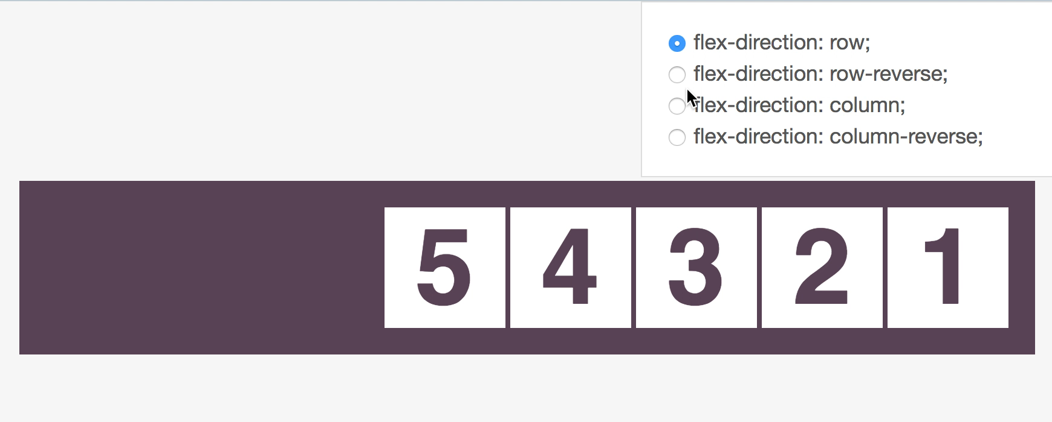
FLEX-DIRECTION AND RTL DIRECTION
CSS
//direction: rtl;
.container { flex-direction: row | row-reverse | column | column-reverse
}
Notes:
flex-direction - specifies how flex items are placed in the flex container defining the main axis and the direction (normal or reversed).
FLEX DIRECTION
Property: flex-direction – the direction flex items are placed in the flex container
Applied to: parent flex container element.
Description: This establishes the main-axis, thus defining the direction flex items are placed in the flex container. Flexbox is (aside from optional wrapping) a single-direction layout concept. Think of flex items as primarily laying out either in horizontal rows or vertical columns.
CSS: flex-direction: row | row-reverse | column | column-reverse
Available values:
row (default): left to right in ltr; right to left inrtl
row-reverse: right to left in ltr; left to right in rtl
column: same as row but top to bottom
column-reverse: same as row-reverse but bottom to top
The flex-direction property specifies how flex items are placed in the flex container, by setting the direction of the flex container’s main axis. This determines the direction that flex items are laid out in. The direction of the axes is affected by the writing mode and directionality of the text (continue reading).
The possible values have the following meanings:
row
This is the initial value. The flex container’s main axis has the same orientation as the current writing mode. The main-start is on the left in a left-to-right language, and the main-end is on the right. In a right-to-left language, the main-start is on the right and the main-end is on the left.
row-reverse
Same as row, except the main-start and main-end directions are swapped. The flex container’s main axis has the opposite orientation as the current writing mode.
column
The flex container’s main axis is rotated so that the main-start is at the top and the main-end is at the bottom. Basically, flex items are laid vertically from top to bottom in a horizontal language. If the language is vertical, then the column value will be horizontal with respect to the language.
column-reverse
Same as column, except that main-start and main-end directions are swapped.
Note that the reverse values do not reverse box ordering; like writing-mode and direction, they only change the direction of flow. Painting order, speech order, and sequential navigation orders are not affected.
The following demo illustrates the result of applying the four flex-direction values to a flex container.

Slide 21
FLEX-WRAP
CSS
//direction: ltr;
.container { flex-wrap: nowrap | wrap | wrap-reverse
}
Notes:
FLEX WRAP
By default, flex items will all try to fit onto one line. You can change that and allow the items to wrap as needed with this property. Direction also plays a role here, determining the direction new lines are stacked in.
Property: flex-wrap – multiline blocks organization inside flex-container.
Applied to: parent flex container element.
Description: specifies whether the children are forced into a single line or if the items can be flowed on multiple lines
CSS: flex-wrap: nowrap | wrap | wrap-reverse
Available values:
nowrap (default): single-line / left to right in ltr; right to left in rtl
wrap: multi-line / left to right in ltr; right to left in rtl
wrap-reverse: multi-line / right to left in ltr; left to right in rtl
The flex-wrap property controls whether the flex container is single-line or multi-line, and the direction of the cross-axis, which determines the direction new lines are stacked in.
The possible values have the following meanings:
nowrap
This is the initial value. The flex container is single-line, and all items are laid out on that line, even if it means they might overflow the container. The direction of the flex line depends on the directionality of the text (see flex-direction above).
wrap
The flex items will wrap onto additional flex lines if there isn’t enough room for them on the first flex line. Additional flex lines are added in the direction of the cross axis, which is affected by the directionality of the text (see flex-direction above).
wrap-reverse
Same as wrap, except the cross-start and cross-end directions are swapped. This means that additional flex lines are added in the opposite direction of the cross axis.

Slide 22
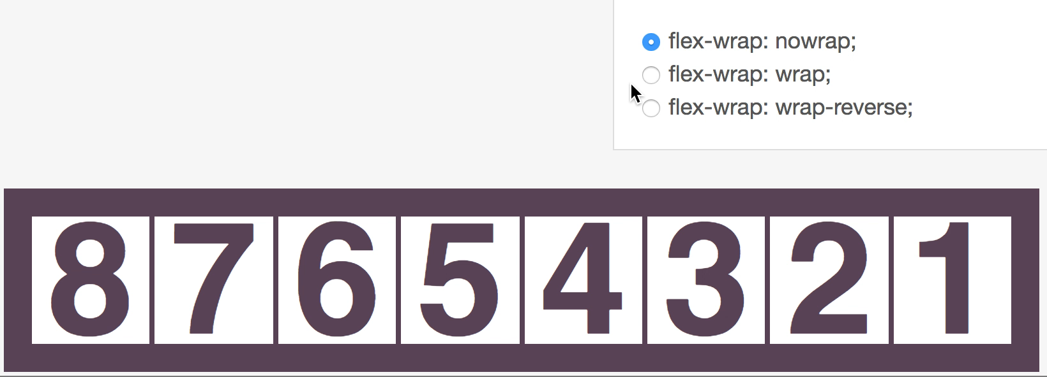
FLEX-WRAP
CSS
//direction: rtl;
.container { flex-wrap: nowrap | wrap | wrap-reverse;
}
Notes:
6
flex-direction - specifies how flex items are placed in the flex container defining the main axis and the direction (normal or reversed).
FLEX DIRECTION
Property: flex-direction – the direction flex items are placed in the flex container
Applied to: parent flex container element.
Description: This establishes the main-axis, thus defining the direction flex items are placed in the flex container. Flexbox is (aside from optional wrapping) a single-direction layout concept. Think of flex items as primarily laying out either in horizontal rows or vertical columns.
CSS: flex-direction: row | row-reverse | column | column-reverse
Available values:
row (default): left to right in ltr; right to left inrtl
row-reverse: right to left in ltr; left to right in rtl
column: same as row but top to bottom
column-reverse: same as row-reverse but bottom to top
The flex-direction property specifies how flex items are placed in the flex container, by setting the direction of the flex container’s main axis. This determines the direction that flex items are laid out in. The direction of the axes is affected by the writing mode and directionality of the text (continue reading).
The possible values have the following meanings:
row
This is the initial value. The flex container’s main axis has the same orientation as the current writing mode. The main-start is on the left in a left-to-right language, and the main-end is on the right. In a right-to-left language, the main-start is on the right and the main-end is on the left.
row-reverse
Same as row, except the main-start and main-end directions are swapped. The flex container’s main axis has the opposite orientation as the current writing mode.
column
The flex container’s main axis is rotated so that the main-start is at the top and the main-end is at the bottom. Basically, flex items are laid vertically from top to bottom in a horizontal language. If the language is vertical, then the column value will be horizontal with respect to the language.
column-reverse
Same as column, except that main-start and main-end directions are swapped.
Note that the reverse values do not reverse box ordering; like writing-mode and direction, they only change the direction of flow. Painting order, speech order, and sequential navigation orders are not affected.
The following demo illustrates the result of applying the four flex-direction values to a flex container.

Slide 23
FLEX-FLOW
flex-flow - shorthand property for flex-direction and flex-wrap individual properties
CSS
.container { flex-flow: <'flex-direction'> <'flex-wrap'>
}
Notes:
FLEX WRAP
By default, flex items will all try to fit onto one line. You can change that and allow the items to wrap as needed with this property. Direction also plays a role here, determining the direction new lines are stacked in.
Property: flex-wrap – multiline blocks organization inside flex-container.
Applied to: parent flex container element.
Description: specifies whether the children are forced into a single line or if the items can be flowed on multiple lines
CSS: flex-wrap: nowrap | wrap | wrap-reverse
Available values:
nowrap (default): single-line / left to right in ltr; right to left in rtl
wrap: multi-line / left to right in ltr; right to left in rtl
wrap-reverse: multi-line / right to left in ltr; left to right in rtl
The flex-wrap property controls whether the flex container is single-line or multi-line, and the direction of the cross-axis, which determines the direction new lines are stacked in.
The possible values have the following meanings:
nowrap
This is the initial value. The flex container is single-line, and all items are laid out on that line, even if it means they might overflow the container. The direction of the flex line depends on the directionality of the text (see flex-direction above).
wrap
The flex items will wrap onto additional flex lines if there isn’t enough room for them on the first flex line. Additional flex lines are added in the direction of the cross axis, which is affected by the directionality of the text (see flex-direction above).
wrap-reverse
Same as wrap, except the cross-start and cross-end directions are swapped. This means that additional flex lines are added in the opposite direction of the cross axis.

Slide 24
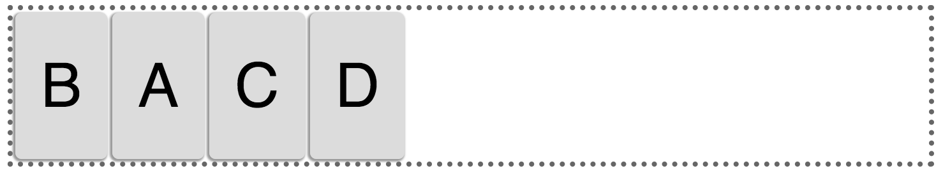
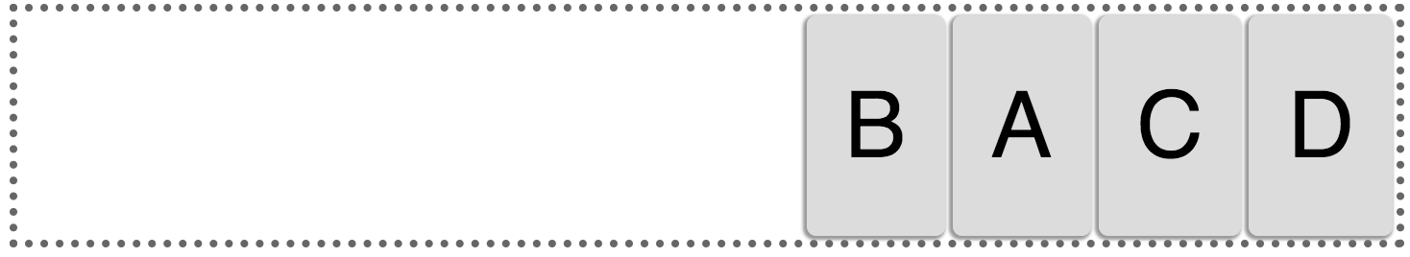
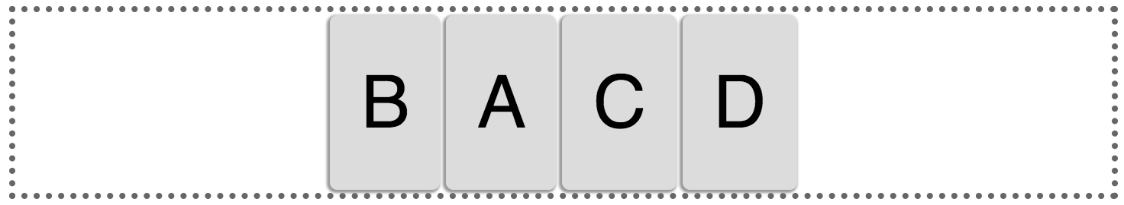
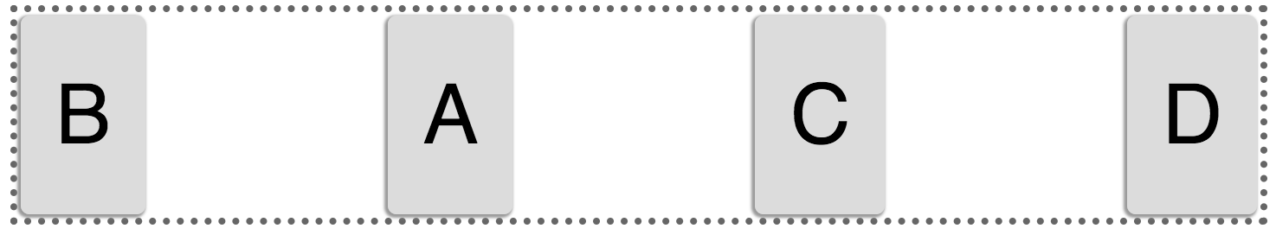
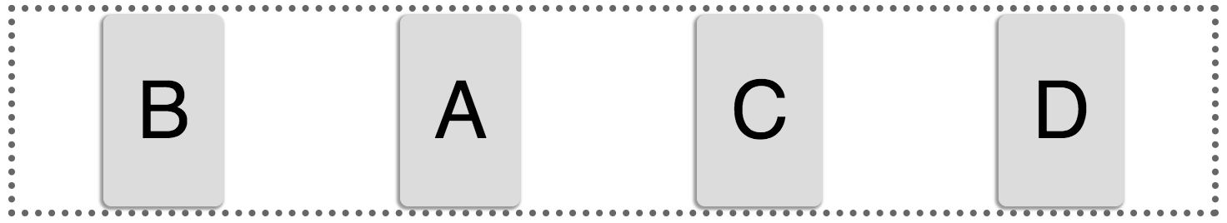
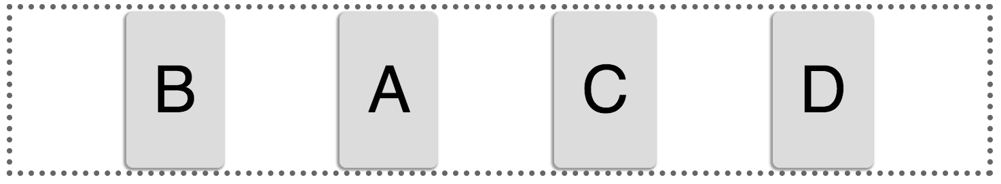
JUSTIFY-CONTENT
CSS
Flex-start
Flex-end
.container { justify-content: flex-start |
flex-end |
center |
space-between | s space-around |
space-evenly; }
Center
Space-between
Space-around
Space-evenly
Notes:
The justify-content property aligns flex items along the main axis of the current line of the flex container. This is done after any flexible lengths and any auto margins have been resolved. Typically it helps distribute extra free space leftover when either all the flex items on a line are inflexible, or are flexible but have reached their maximum size. It also exerts some control over the alignment of items when they overflow the line.
The possible values have the following meanings:
flex-start
This is the initial value. Flex items are packed toward the start of the line.
flex-end
Flex items are packed toward the end of the line.
center
Flex items are packed toward the center of the line, with equal amounts of empty space between the main-start edge of the line and the first item on the line and between the main-end edge of the line and the last item on the line. (If the leftover free-space is negative, the flex items will overflow equally in both directions.)
space-between
Flex items are evenly distributed in the line. If the leftover free-space is negative or there is only a single flex item on the line, this value is identical to flex-start. Otherwise, the first flex item on the line is placed on the main-start edge of the line, the last flex item on the line is on the main-end edge of the line, and the remaining flex items on the line are distributed so that the spacing between any two adjacent items is the same.
space-around
Flex items are evenly distributed in the line, with half-size spaces on either end. If the leftover free-space is negative or there is only a single flex item on the line, this value is identical to center. Otherwise, the flex items on the line are distributed such that the spacing between any two adjacent flex items on the line is the same, and the spacing between the first/last flex items and the flex container edges is half the size of the spacing between flex items.
JUSTIFY CONTENT
Property: justify-content – alignment along the main axis.
Applied to: parent flex container element.
Description: This defines the alignment along the main axis. It helps distribute extra free space left over when either all the flex items on a line are inflexible, or are flexible but have reached their maximum size. It also exerts some control over the alignment of items when they overflow the line.
CSS: justify-content: flex-start | flex-end | center | space-between | space-around
Available values:
flex-start: (default): items are packed toward the start line
flex-end: items are packed toward to end line
center: items are centered along the line
space-between: items are evenly distributed in the line; first item is on the start line, last item on the end line
space-around: items are evenly distributed in the line with equal space around them. Note that visually the spaces aren't equal, since all the items have equal space on both sides. The first item will have one unit of space against the container edge, but two units of space between the next item because that next item has its own spacing that applies.

Slide 25
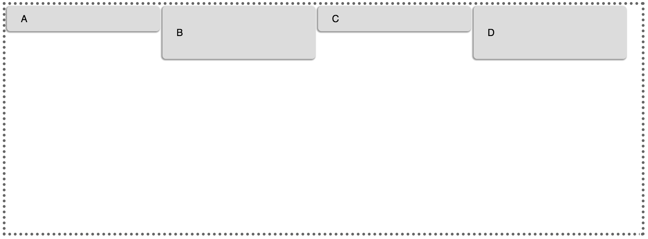
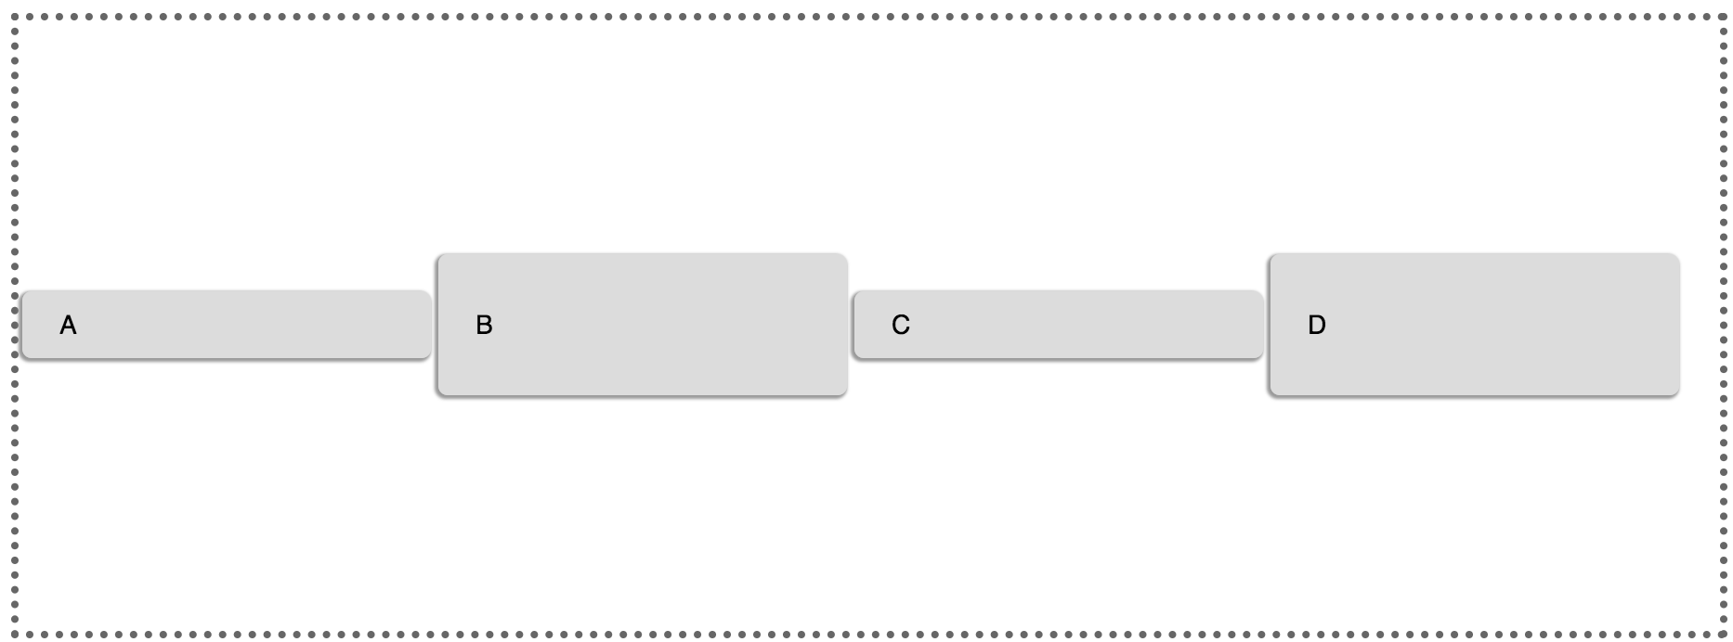
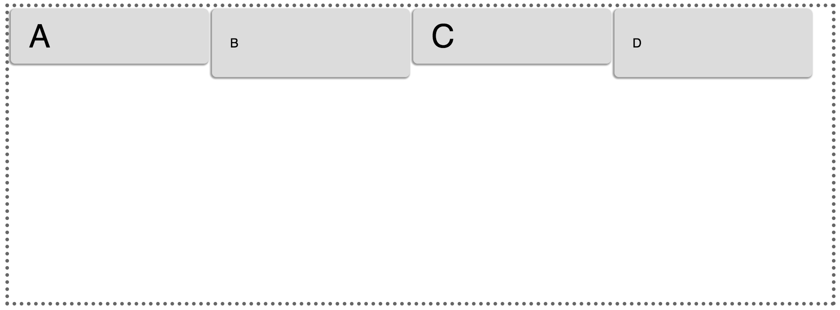
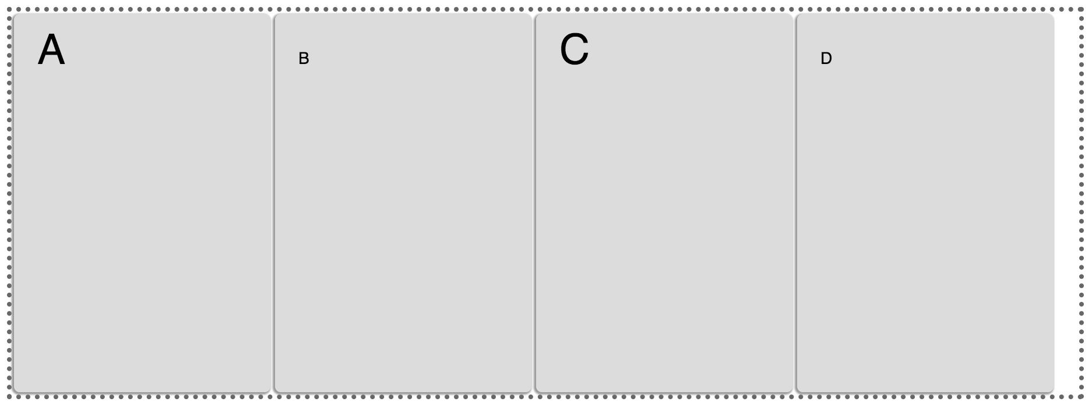
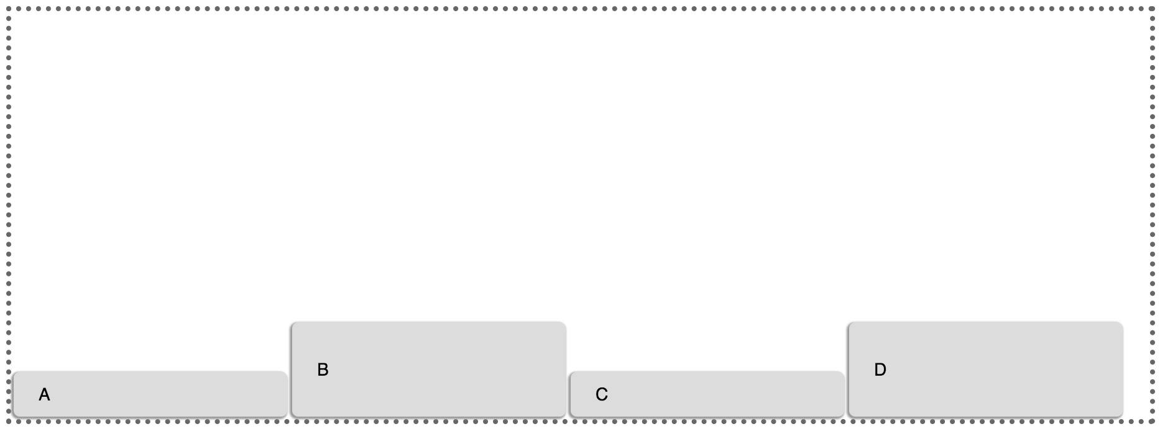
ALIGN-ITEMS
CSS
Baseline
Stretch
Flex-end
Flex-start
.container { align-items: flex-start |
flex-end |
center |
baseline |
stretch; }
​
Center
Notes:
ALIGN ITEMS
Property: align-items – alignment along the cross axis.
Applied to: parent flex container element.
Description: This defines the default behavior for how flex items are laid out along the cross axis on the current line. Think of it as the justify-content version for the cross-axis (perpendicular to the main-axis).
CSS: align-items: flex-start | flex-end | center | baseline | stretch
Available values:
flex-start: cross-start margin edge of the items is placed on the cross-start line
flex-end: cross-end margin edge of the items is placed on the cross-end line
center: items are centered in the cross-axis
baseline: items are aligned such as their baselines align
stretch (default): stretch to fill the container (still respect min-width/max-width)

Slide 26
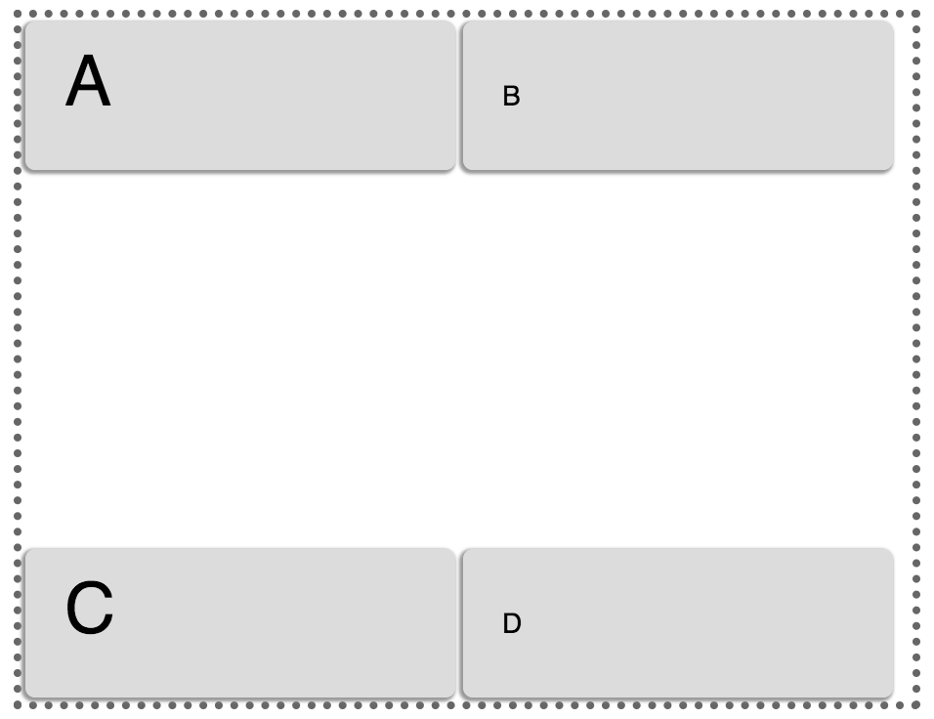
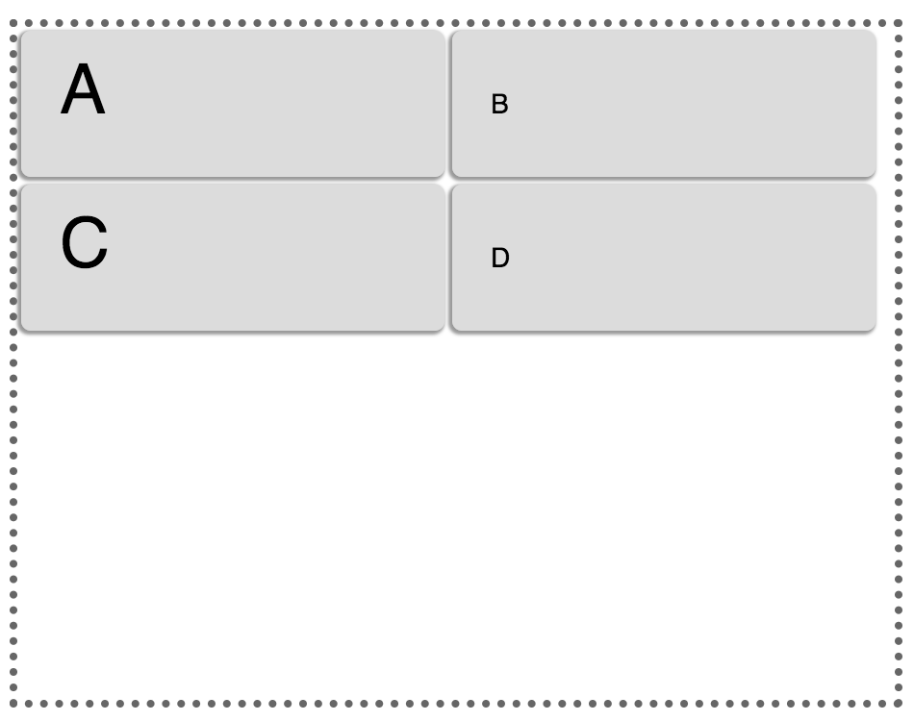
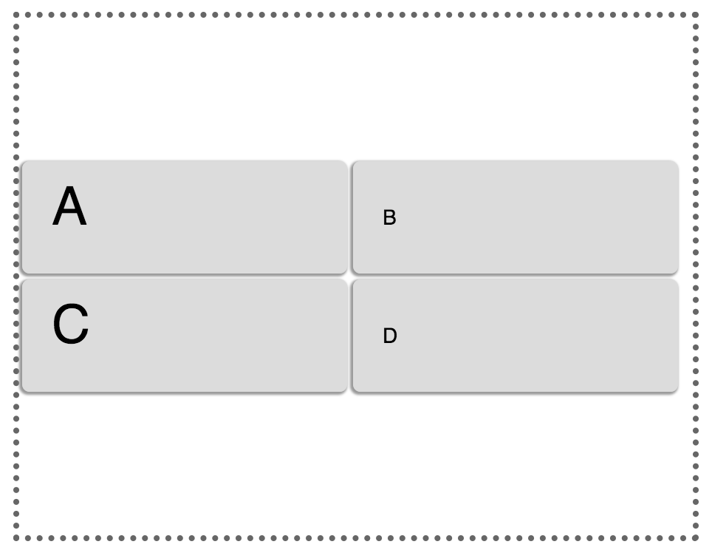
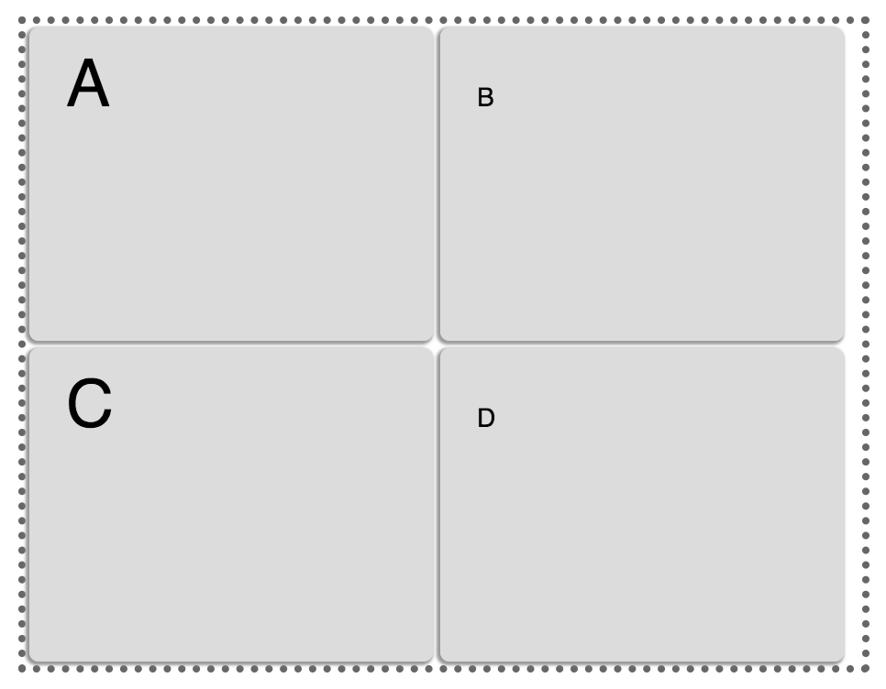
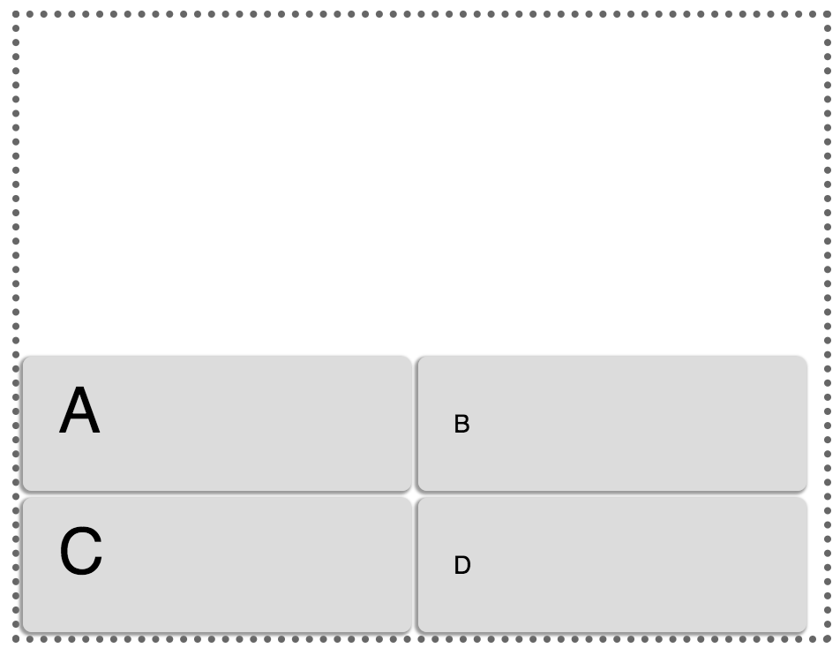
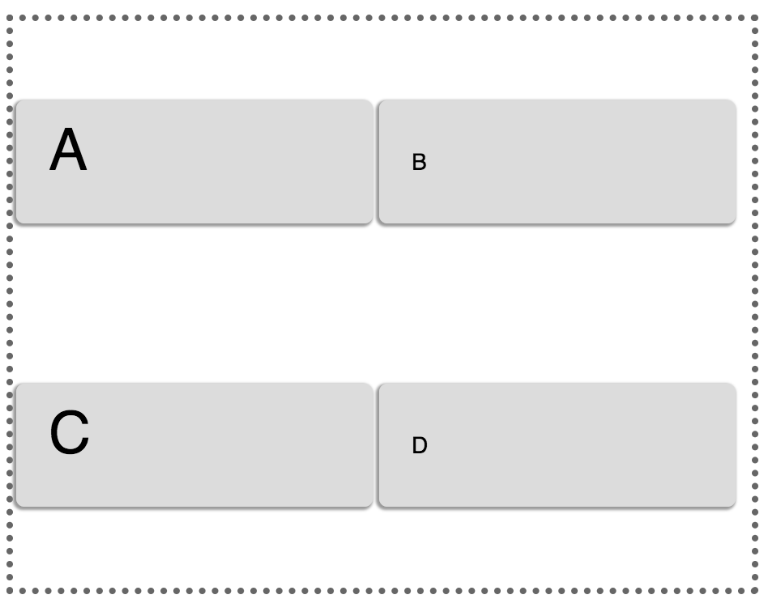
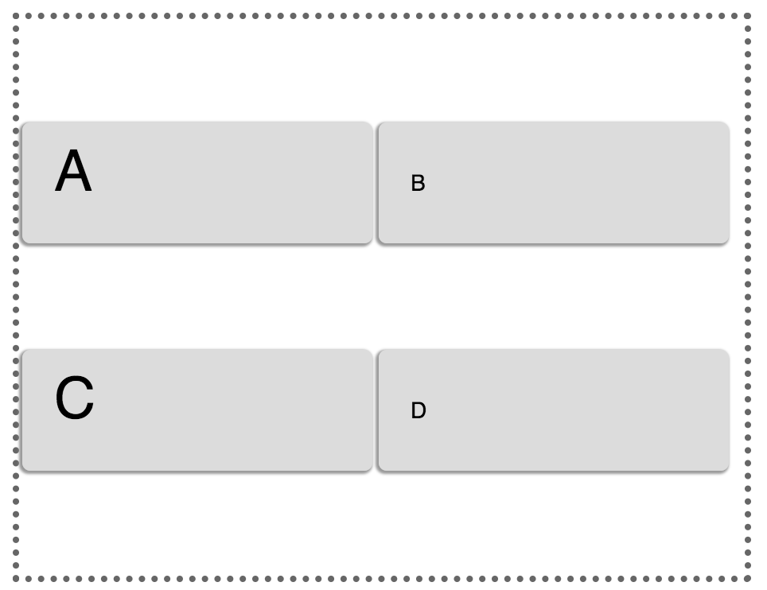
ALIGN-CONTENT
ALIGN-CONTENT
Space-around
CSS
Center
Space-evenly
Stretch
Flex-start
Space-between
Flex-end
​
.container { align-content: flex-start |
flex-end |
space-around |
center |
stretch |
space-between |
space-evenly; }
​
Notes:
The align-content property aligns a flex container’s lines within the flex container when there is extra space in the cross-axis, similar to how justify-content aligns individual items within the main-axis. This property has no effect when the flex container has only a single line.
The possible values have the following meanings:
flex-start
Lines are packed toward the cross-start of the flex container.
flex-end
Lines are packed toward the cross-end of the flex container.
center
Lines are packed toward the center of the flex container, with equal amounts of empty space between the cross-start edge of the container and the first line in the container and between the cross-end edge of the container and the last line in the container. (If the leftover free-space is negative, the lines will overflow equally in both directions.)
space-between
Lines are evenly distributed in the flex container. If the leftover free-space is negative this value is identical to flex-start. Otherwise, the cross-start edge of the first line in the flex container is placed on the cross-start content edge of the flex container, the cross-end edge of the last line in the flex container is placed on the cross-end content edge of the flex container, and the remaining lines in the flex container are distributed so that the spacing between any two adjacent lines is the same.
space-around
Lines are evenly distributed in the flex container, with half-size spaces on either end. If the leftover free-space is negative this value is identical to center. Otherwise, the lines in the flex container are distributed such that the spacing between any two adjacent lines is the same, and the spacing between the first/last lines and the flex container edges is half the size of the spacing between flex lines.
stretch
This is the initial value. Lines stretch to take up the remaining space. If the leftover free-space is negative, this value is identical to flex-start. Otherwise, the free-space is split equally between all of the lines, increasing their cross size.
Note that only flex containers with multiple lines ever have free space in the cross-axis for lines to be aligned in, because in a flex container with a single line the sole line automatically stretches to fill the space (that’s the default behavior).
the align-content property only works on a flex container that is multi-line.
ALIGN CONTENT
Property: align-content
Applied to: parent flex container element.
Description: This aligns a flex container's lines within when there is extra space in the cross-axis, similar to how justify-content aligns individual items within the main-axis.
Note: this property has no effect when there is only one line of flex items.
CSS: align-content: flex-start | flex-end | center | space-between | space-around | stretch
Available values:
flex-start: lines packed to the start of the container
flex-end: lines packed to the end of the container
center: lines packed to the center of the container
space-between: lines evenly distributed; the first line is at the start of the container while the last one is at the end
space-around: lines evenly distributed with equal space around each line
stretch (default): lines stretch to take up the remaining space

Slide 27
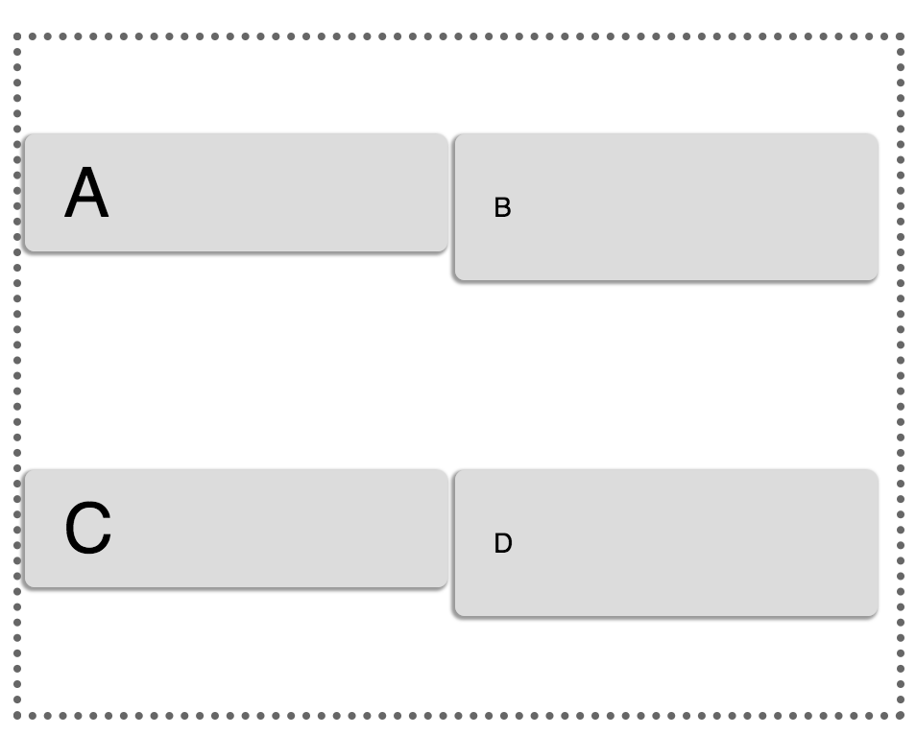
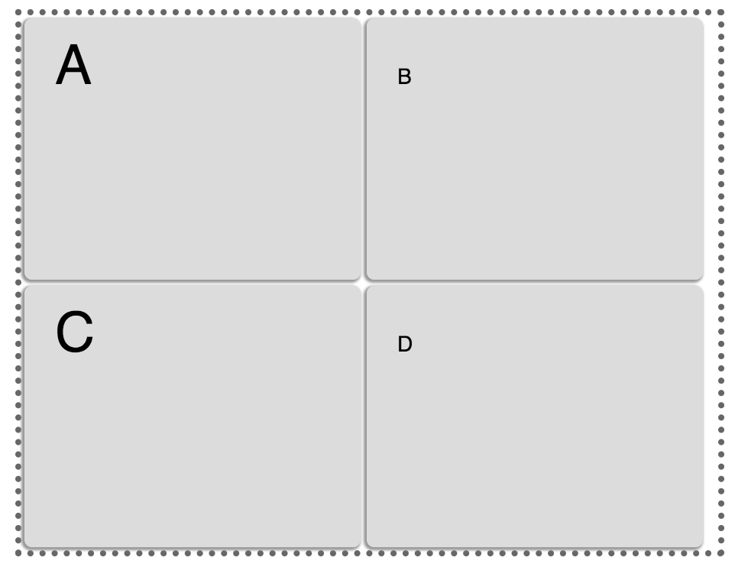
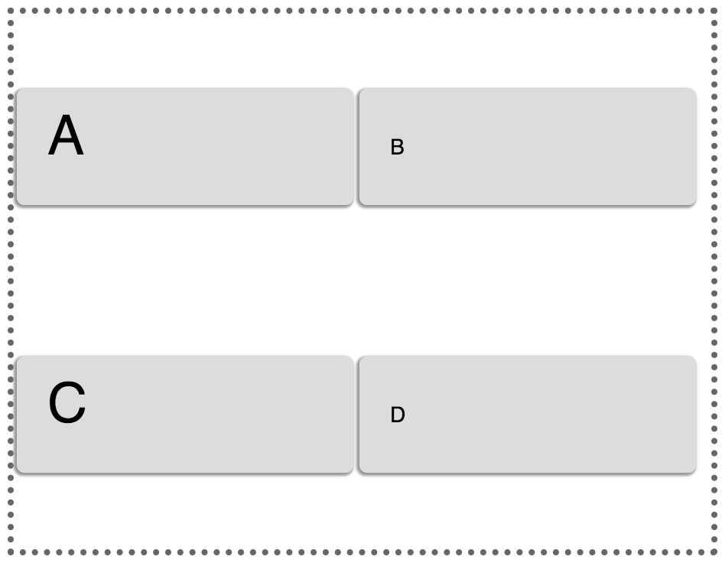
ALIGN-ITEMS VS ALIGN-CONTENT
Difference between align-items & align-content
​
.container { align-content: space –around; //align-items: stretch; }
​
​
.container { align-content: stretch; //align-items: stretch; }
​
​
.container { align-content: space-around;
align-items: flex-start; }
​

Slide 28
CONTAINER PROPERTIES SUMMARY
flex-direction
flex-wrap
flex-flow
justify-content
align-items
align-content
Notes:
The align-content property aligns a flex container’s lines within the flex container when there is extra space in the cross-axis, similar to how justify-content aligns individual items within the main-axis. This property has no effect when the flex container has only a single line.
The possible values have the following meanings:
flex-start
Lines are packed toward the cross-start of the flex container.
flex-end
Lines are packed toward the cross-end of the flex container.
center
Lines are packed toward the center of the flex container, with equal amounts of empty space between the cross-start edge of the container and the first line in the container and between the cross-end edge of the container and the last line in the container. (If the leftover free-space is negative, the lines will overflow equally in both directions.)
space-between
Lines are evenly distributed in the flex container. If the leftover free-space is negative this value is identical to flex-start. Otherwise, the cross-start edge of the first line in the flex container is placed on the cross-start content edge of the flex container, the cross-end edge of the last line in the flex container is placed on the cross-end content edge of the flex container, and the remaining lines in the flex container are distributed so that the spacing between any two adjacent lines is the same.
space-around
Lines are evenly distributed in the flex container, with half-size spaces on either end. If the leftover free-space is negative this value is identical to center. Otherwise, the lines in the flex container are distributed such that the spacing between any two adjacent lines is the same, and the spacing between the first/last lines and the flex container edges is half the size of the spacing between flex lines.
stretch
This is the initial value. Lines stretch to take up the remaining space. If the leftover free-space is negative, this value is identical to flex-start. Otherwise, the free-space is split equally between all of the lines, increasing their cross size.
Note that only flex containers with multiple lines ever have free space in the cross-axis for lines to be aligned in, because in a flex container with a single line the sole line automatically stretches to fill the space (that’s the default behavior).
the align-content property only works on a flex container that is multi-line.
ALIGN CONTENT
Property: align-content
Applied to: parent flex container element.
Description: This aligns a flex container's lines within when there is extra space in the cross-axis, similar to how justify-content aligns individual items within the main-axis.
Note: this property has no effect when there is only one line of flex items.
CSS: align-content: flex-start | flex-end | center | space-between | space-around | stretch
Available values:
flex-start: lines packed to the start of the container
flex-end: lines packed to the end of the container
center: lines packed to the center of the container
space-between: lines evenly distributed; the first line is at the start of the container while the last one is at the end
space-around: lines evenly distributed with equal space around each line
stretch (default): lines stretch to take up the remaining space

Slide 29
flex item PROPERTIES

Slide 30
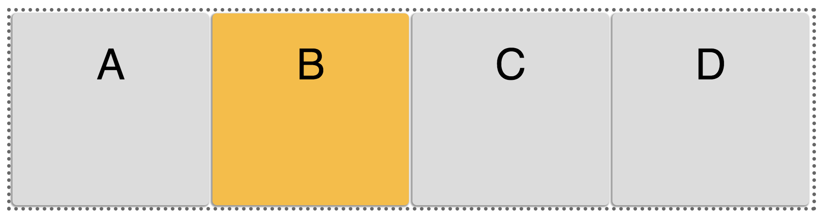
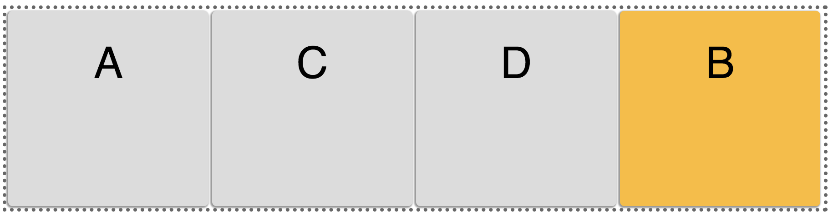
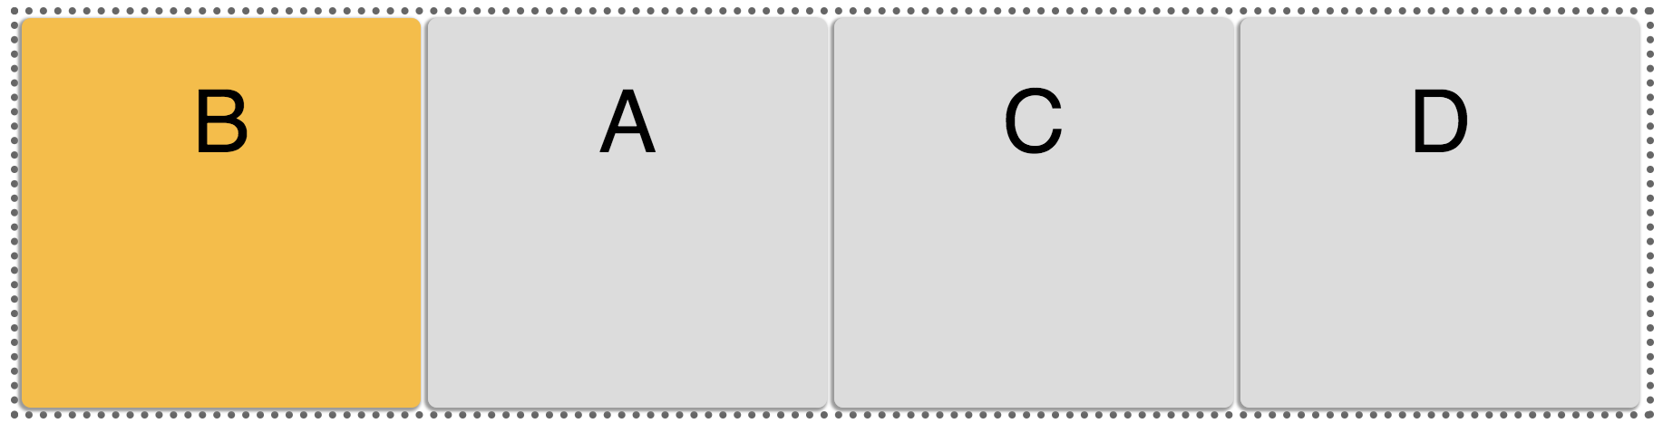
ORDER
CSS
.second { order: <integer>; }
​
default
.B { order: 1; }
.B { order: -1 }
Notes:
Flex items are, by default, displayed and laid out in the same order as they appear in the source document. The order property can be used to change this ordering.
The order property controls the order in which flex items appear within their flex container, by assigning them to ordinal groups. It takes a single <integer> value, which specifies which ordinal group the flex item belongs to.
Then, a flex container lays out its content in order-modified document order, starting from the lowest numbered ordinal group and going up. Items with the same ordinal group are laid out in the order they appear in the source document.
The initial order of all flex items is zero (0) and the flex items are rendered in the order they appear in the source code. The order property can also take negative values.
Note that the order in which the flex item appears inside its container changes only on screen, not in the source document. This means that screen readers will read the flex items in the order they appear in the document source, not the order specified using the order property. The default traversal order of sequential navigation modes (such as cycling through links, for example using nav-index or tabindex) is also not affected (except in Firefox, which changes the order of traversal of links based on the visual order). Hence, you should use the order property only for visual, not logical, reordering of content.
This property could be useful for reordering blog posts, for example, where you may want to feature a blog post at the beginning of the page, even if that article is no longer the latest. The logical order that is accessible for screen readers will be maintained, and the article can be visually replaced without affecting the accessibility.
Try changing the order of the items in the following flex container to see how they are reordered visually.
ORDER
For this, we use the order property.
Property: order – order of certain flex-item inside flex-container.
Applied to: inner flex item element.
Description: By default, flex items are laid out in the source order. However, the order property controls the order in which they appear in the flex container. It is an integer and defaults to 0. Value of order does not specify the absolute position of the element in the sequence. It identifies all the item's position.
CSS: order: <integer>
Available values: number. To put a block very first, give it order: -1:
Example:
<div class="my-flex-container"> <div class="my-flex-block" style="order: 5" >item1</div> <div class="my-flex-block" style="order: 10">item2</div> <div class="my-flex-block" style="order: 5" >item3</div> <div class="my-flex-block" style="order: 5" >item4</div> <div class="my-flex-block" style="order: 0" >item5</div> </div>
In this case, the blocks will follow one another along the major axis in the following order: item5, item1, item3, item4, item2

Slide 31
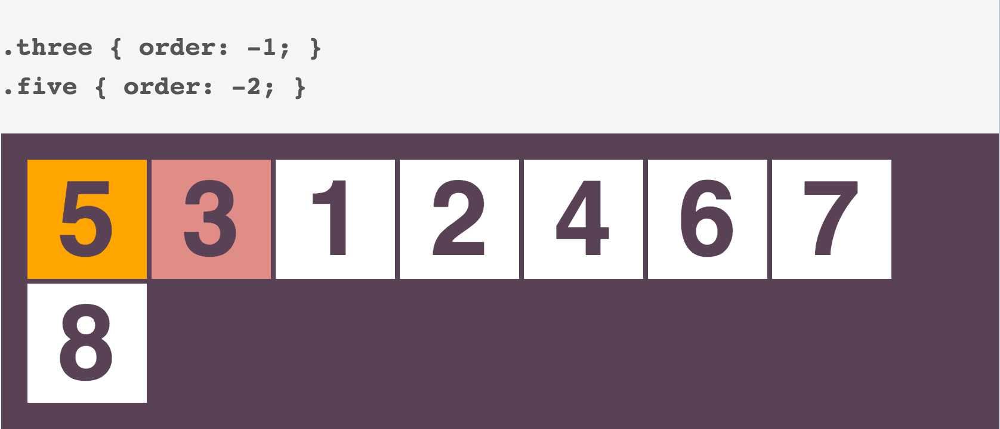
ORDER
Notes:
8
Flex items are, by default, displayed and laid out in the same order as they appear in the source document. The order property can be used to change this ordering.
The order property controls the order in which flex items appear within their flex container, by assigning them to ordinal groups. It takes a single <integer> value, which specifies which ordinal group the flex item belongs to.
Then, a flex container lays out its content in order-modified document order, starting from the lowest numbered ordinal group and going up. Items with the same ordinal group are laid out in the order they appear in the source document.
The initial order of all flex items is zero (0) and the flex items are rendered in the order they appear in the source code. The order property can also take negative values.
Note that the order in which the flex item appears inside its container changes only on screen, not in the source document. This means that screen readers will read the flex items in the order they appear in the document source, not the order specified using the order property. The default traversal order of sequential navigation modes (such as cycling through links, for example using nav-index or tabindex) is also not affected (except in Firefox, which changes the order of traversal of links based on the visual order). Hence, you should use the order property only for visual, not logical, reordering of content.
This property could be useful for reordering blog posts, for example, where you may want to feature a blog post at the beginning of the page, even if that article is no longer the latest. The logical order that is accessible for screen readers will be maintained, and the article can be visually replaced without affecting the accessibility.
Try changing the order of the items in the following flex container to see how they are reordered visually.
ORDER
For this, we use the order property.
Property: order – order of certain flex-item inside flex-container.
Applied to: inner flex item element.
Description: By default, flex items are laid out in the source order. However, the order property controls the order in which they appear in the flex container. It is an integer and defaults to 0. Value of order does not specify the absolute position of the element in the sequence. It identifies all the item's position.
CSS: order: <integer>
Available values: number. To put a block very first, give it order: -1:
Example:
<div class="my-flex-container"> <div class="my-flex-block" style="order: 5" >item1</div> <div class="my-flex-block" style="order: 10">item2</div> <div class="my-flex-block" style="order: 5" >item3</div> <div class="my-flex-block" style="order: 5" >item4</div> <div class="my-flex-block" style="order: 0" >item5</div> </div>
In this case, the blocks will follow one another along the major axis in the following order: item5, item1, item3, item4, item2

Slide 32
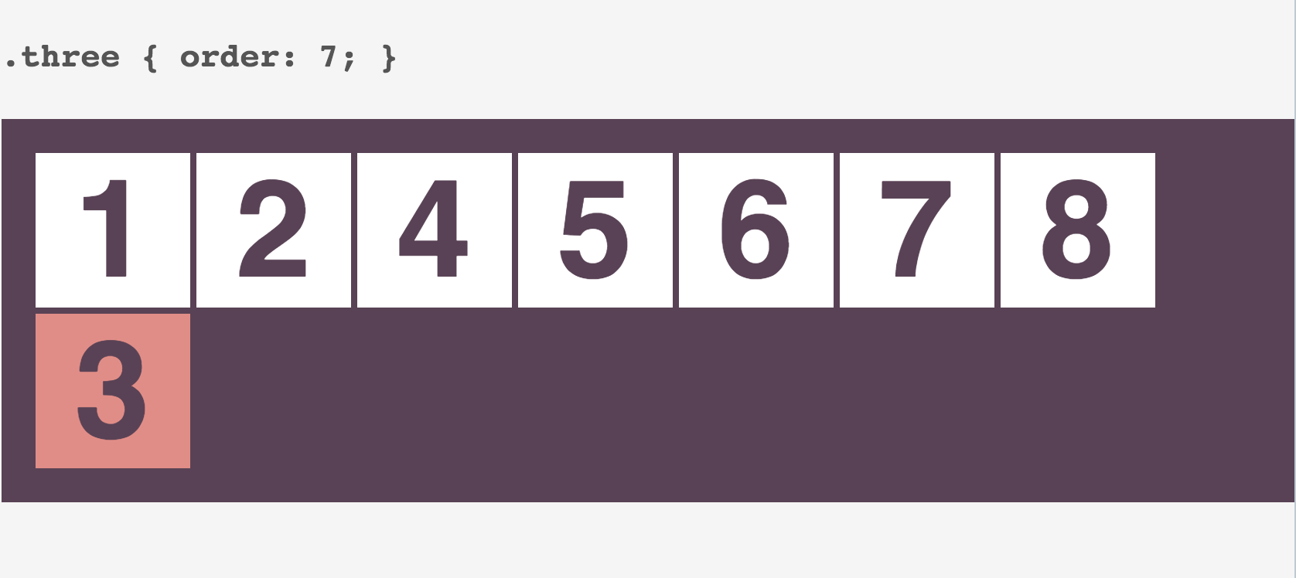
ORDER
Notes:
9
Flex items are, by default, displayed and laid out in the same order as they appear in the source document. The order property can be used to change this ordering.
The order property controls the order in which flex items appear within their flex container, by assigning them to ordinal groups. It takes a single <integer> value, which specifies which ordinal group the flex item belongs to.
Then, a flex container lays out its content in order-modified document order, starting from the lowest numbered ordinal group and going up. Items with the same ordinal group are laid out in the order they appear in the source document.
The initial order of all flex items is zero (0) and the flex items are rendered in the order they appear in the source code. The order property can also take negative values.
Note that the order in which the flex item appears inside its container changes only on screen, not in the source document. This means that screen readers will read the flex items in the order they appear in the document source, not the order specified using the order property. The default traversal order of sequential navigation modes (such as cycling through links, for example using nav-index or tabindex) is also not affected (except in Firefox, which changes the order of traversal of links based on the visual order). Hence, you should use the order property only for visual, not logical, reordering of content.
This property could be useful for reordering blog posts, for example, where you may want to feature a blog post at the beginning of the page, even if that article is no longer the latest. The logical order that is accessible for screen readers will be maintained, and the article can be visually replaced without affecting the accessibility.
Try changing the order of the items in the following flex container to see how they are reordered visually.
ORDER
For this, we use the order property.
Property: order – order of certain flex-item inside flex-container.
Applied to: inner flex item element.
Description: By default, flex items are laid out in the source order. However, the order property controls the order in which they appear in the flex container. It is an integer and defaults to 0. Value of order does not specify the absolute position of the element in the sequence. It identifies all the item's position.
CSS: order: <integer>
Available values: number. To put a block very first, give it order: -1:
Example:
<div class="my-flex-container"> <div class="my-flex-block" style="order: 5" >item1</div> <div class="my-flex-block" style="order: 10">item2</div> <div class="my-flex-block" style="order: 5" >item3</div> <div class="my-flex-block" style="order: 5" >item4</div> <div class="my-flex-block" style="order: 0" >item5</div> </div>
In this case, the blocks will follow one another along the major axis in the following order: item5, item1, item3, item4, item2

Slide 33
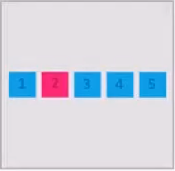
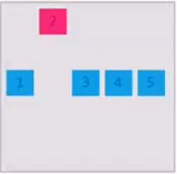
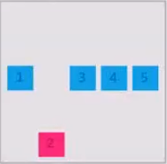
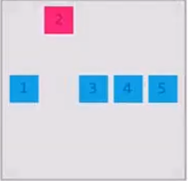
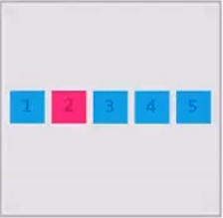
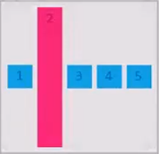
align-self
.container {
align-items: center;
}
.item { align-self: flex-start |
flex-end |
center |
baseline |
stretch |
auto (default); }
​
CSS
auto (default)
flex-start
flex-end
baseline
center
stretch
Notes:
The align-self CSS property aligns flex items of the current flex line overriding the align-items value. If any of the item's cross-axis margin is set to auto, then align-self is ignored.

Slide 34
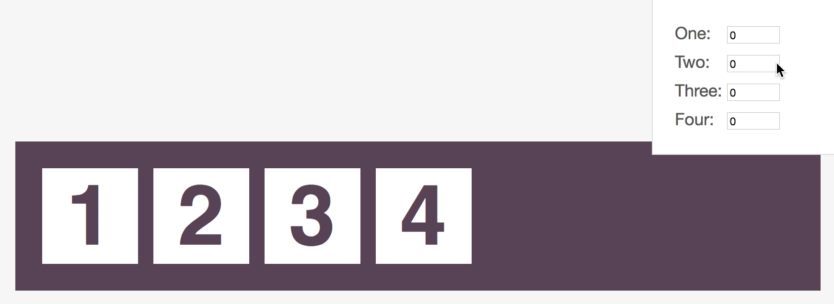
FLEX-GROW
CSS
.item { flex-grow: <number>; /* default 0 */ }​
Notes:
The flex-grow property sets the flex grow factor of a flex item. A flex grow factor is a <number> which determines how much the flex item will grow relative to the rest of the flex items in the flex container when positive free space is distributed. The initial value is zero (0), and negative numbers are invalid.
If the flex items are laid out on the flex line such that they don’t take up the entire space on that line, you can “expand” the flex items so that they fill up the entire line. The amount of available space on the line can be distributed among the flex items following a specific proportion that you can specify using the flex-grow property. The higher the flex-grow value, the more the item will be allowed to grow relative to the other items.
For example, you can distribute the space among the flex items such that one of these items always gets twice as much space as the others. You can do that by setting the flex-grow property value to 2 (two). An item with flex-grow: 2 will grow twice as much as an item with flex-grow: 1—it gets twice as much space as the latter. So, for every one pixel that the second item gets, the first item grows by two pixels.
Try entering different values for the flex-grow property in the following demo to see how the elements grow.
FLEX GROW
Property: flex-grow – flex grow factor of a flex item
Applied to: inner flex item element
Description: This defines the ability for a flex item to grow if necessary. It accepts a unitless value that serves as a proportion. It dictates what amount of the available space inside the flex container the item should take up.
CSS: flex-grow: <number> (по умолчанию 0)
Note: Negative numbers are invalid.
Example 1:
If all items have flex-grow set to 1, the remaining space in the container will be distributed equally to all children. If one of the children a value of 2, the remaining space would take up twice as much space as the others (or it will try to, at least).
Example 2:
If all items have flex-grow set to 3, the remaining space in the container will be distributed equally to all children.
If one of them has flex-grow:12, it will take up the remaining space in four times greater than others.
I.е. the absolute value of flex-grow doesn't define the exact width. It determines the degree of "greed" in relation to other flex-items of the same level.

Slide 35
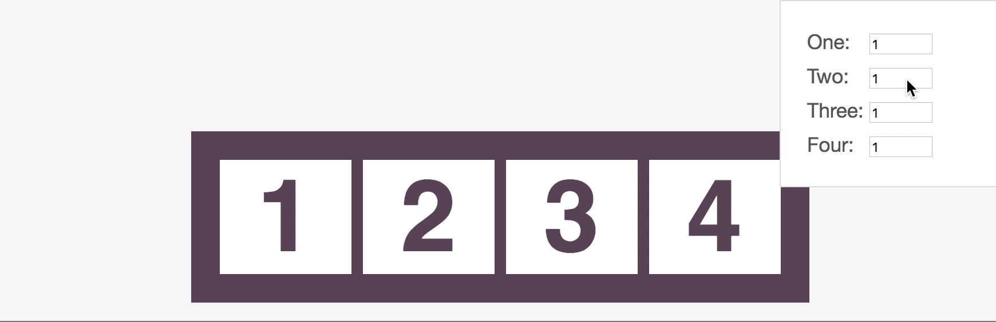
FLEX-SHRINK
CSS
.item { flex-shrink: <number>; /* default 1 */ }​
Notes:
The flex-shrink property sets the flex shrink factor of a flex item. A flex shrink factor is a <number> which determines how much the flex item will shrink relative to the rest of the flex items in the flex container when negative free space is distributed. The flex shrink factor is multiplied by the flex basis (see flex-basis) when distributing negative space. The initial value is zero (1), meaning that the items don’t shrink by default, and negative numbers are invalid.
If the sum of the main sizes (see concepts and terminology) of all flex items is greater than the main size of the flex container, you can specify just by how much you want to “shrink” the flex items. The amount by which the flex items’ main sizes exceed the container’s main size is the negative space. Using the flex-shrink property, you can distribute this negative space over the flex items. The negative space is distributed in proportion to flex-basis multiplied by the flex-shrink ratio, where the flex basis is the initial main size of the flex item, before free space is distributed according to the flex factors.
For example, you can distribute the space among the flex items such that one of these items always gets twice as much negative space as the others. You can do that by setting the flex-shrink property value to 2 (two). An item with flex-shrink: 2 will shrink twice as much as an item with flex-shrink: 1—it gets twice as much negative space as the latter. So, for every one pixel that the second item shrinks, the first item shrinks by two pixels. The higher the flex-shrink value, the more the item will shrink relative to the other items.
The items in the following demo are laid inside a container that has a main size of 500px. Each of the four items has a main size basis (or a flex basis) of 200px. The items (combined) obviously have a larger main size than the container’s. Because this is a Flexbox layout, the items will automatically shrink to fit inside their container. However, using the flex-shrink property, you can control the ratio by which the items are to be shrunk. Try entering different values for the flex-shrink property in the following demo to see how the elements shrink.
EXAMPLE
The items in the following demo are laid inside a container that has a main size of 500px. Each of the four items has a main size basis (or a flex basis) of 200px. The items (combined) obviously have a larger main size than the container’s. Because this is a Flexbox layout, the items will automatically shrink to fit inside their container. However, using the flex-shrink property, you can control the ratio by which the items are to be shrunk. Try entering different values for the flex-shrink property in the following demo to see how the elements shrink.
FLEX SHRINK
Property: flex-shrink – the ability for a flex item to shrink
Applied to: inner flex item element
Description: This defines the ability for a flex item to shrink if necessary (how much flex-flow will decrease relative to the adjacent elements inside flex-container in the case of lack of space).
CSS: flex-shrink: <number> (default 1)
Note: Negative numbers are invalid.

Slide 36
FLEX-BASIS
flex-basis - specifies the default size of an element before the remaining space is distributed
CSS
.item { flex-basis: <length> | <auto> | <content>; /* default auto */ }​
Notes:
The flex-basis property takes the same values as the width property, and sets the flex basis: the initial main size (see concepts and terminology) of the flex item, before free space is distributed according to the flex factors (see flex-shrink and flex-grow).
Except for auto, flex-basis is resolved the same way as width in horizontal writing modes: percentage values for the flex-basis property are set relative to the flex container’s inner main size. Also, flex-basis determines the size of the element’s content box, unless otherwise specified using the box-sizing property.
If the specified flex-basis is auto, the used flex basis is the value of the flex item’s main size property. (This can itself be the keyword auto, which sizes the flex item based on its contents.)
The flex-basis property is usually used in conjunction with the flex-shrink and flex-grow properties, in the shorthand flex property.
In the following demo, the flex-basis is used in the flex shorthand. The flex-shrink and flex-grow properties are set so that the items neither grow nor shrink. The value specified using flex-basis defines the main size of each item. Try changing the values of all three properties in the flex shorthand to see how the width of the items responds. For example, try using a different flex-grow value to see how the size of an item changes after positive space is distributed.
FLEX BASIS
Property: flex-basis – the default size of an flex-item before the remaining space is distributed.
Applied to: inner flex item element
Description: The flex-basis property in CSS specifies the flex basis width based on which a flex item shrinks or flex according to the flexibility defined using flex-grow, flex-shrink or the shorthand property flex.
This defines the default size of an element before the remaining space is distributed. It can be a length (e.g. 20%, 5rem, etc.) or a keyword. The auto keyword means "look at my width or height property" (which was temporarily done by the main-size keyword until deprecated). The content keyword means "size it based on the item's content" - this keyword isn't well supported yet, so it's hard to test and harder to know what it's brethren max-content, min-content, andfit-content do.
If set to 0, the extra space around content isn't factored in. If set to auto, the extra space is distributed based on its flex-grow value.
CSS: flex-basis: <length> | auto (default auto)
Note: Negative numbers are invalid.
Example:
.flex-box{
border: 7px solid silver;
display: flex;
height: 200px;
}
.flex-box div:nth-of-type(1){
background: rgb(0, 137, 250);
flex-basis: 10%;
}
.flex-box div:nth-of-type(2){
background: rgb(255, 0, 43);
flex-basis: 20%;
}
.flex-box div:nth-of-type(3){
background: rgb(255, 169, 0);
flex-basis: 30%;
}
.flex-box div:nth-of-type(4){
background: rgb(0, 167, 83);
flex-basis: 40%;
}

Slide 37
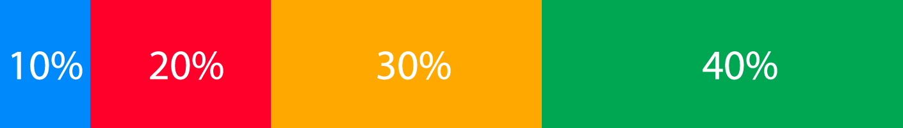
FLEX-BASIS
CSS
.container{
border: 7px solid silver;
display: flex;
height: 200px;
}
.container div:nth-of-type(1){
background: rgb(0, 137, 250);
flex-basis: 10%;
}
.container div:nth-of-type(2){
background: rgb(255, 0, 43);
flex-basis: 20%;
}
.container div:nth-of-type(3){
background: rgb(255, 169, 0);
flex-basis: 30%;
}
.container div:nth-of-type(4){
background: rgb(0, 167, 83);
flex-basis: 40%;
}
10%
20%
30%
Notes:
The flex-basis property takes the same values as the width property, and sets the flex basis: the initial main size (see concepts and terminology) of the flex item, before free space is distributed according to the flex factors (see flex-shrink and flex-grow).
Except for auto, flex-basis is resolved the same way as width in horizontal writing modes: percentage values for the flex-basis property are set relative to the flex container’s inner main size. Also, flex-basis determines the size of the element’s content box, unless otherwise specified using the box-sizing property.
If the specified flex-basis is auto, the used flex basis is the value of the flex item’s main size property. (This can itself be the keyword auto, which sizes the flex item based on its contents.)
The flex-basis property is usually used in conjunction with the flex-shrink and flex-grow properties, in the shorthand flex property.
In the following demo, the flex-basis is used in the flex shorthand. The flex-shrink and flex-grow properties are set so that the items neither grow nor shrink. The value specified using flex-basis defines the main size of each item. Try changing the values of all three properties in the flex shorthand to see how the width of the items responds. For example, try using a different flex-grow value to see how the size of an item changes after positive space is distributed.
FLEX BASIS
Property: flex-basis – the default size of an flex-item before the remaining space is distributed.
Applied to: inner flex item element
Description: The flex-basis property in CSS specifies the flex basis width based on which a flex item shrinks or flex according to the flexibility defined using flex-grow, flex-shrink or the shorthand property flex.
This defines the default size of an element before the remaining space is distributed. It can be a length (e.g. 20%, 5rem, etc.) or a keyword. The auto keyword means "look at my width or height property" (which was temporarily done by the main-size keyword until deprecated). The content keyword means "size it based on the item's content" - this keyword isn't well supported yet, so it's hard to test and harder to know what it's brethren max-content, min-content, andfit-content do.
If set to 0, the extra space around content isn't factored in. If set to auto, the extra space is distributed based on its flex-grow value.
CSS: flex-basis: <length> | auto (default auto)
Note: Negative numbers are invalid.
Example:
.flex-box{
border: 7px solid silver;
display: flex;
height: 200px;
}
.flex-box div:nth-of-type(1){
background: rgb(0, 137, 250);
flex-basis: 10%;
}
.flex-box div:nth-of-type(2){
background: rgb(255, 0, 43);
flex-basis: 20%;
}
.flex-box div:nth-of-type(3){
background: rgb(255, 169, 0);
flex-basis: 30%;
}
.flex-box div:nth-of-type(4){
background: rgb(0, 167, 83);
flex-basis: 40%;
}

Slide 38
FLEX
flex - specifying the ability of a flex item to alter its dimensions to fill available space
CSS
.item { flex: none | [ <‘flex-grow'> <'flex-shrink'>? || <'flex-basis'> ] }​
Notes:
FLEX
Property: flex – shorthand for flex-grow, flex-shrinkand flex-basis.
Applied to: inner flex item element.
Description: This is the shorthand for flex-grow, flex-shrinkand flex-basis combined. The second and third parameters (flex-shrink and flex-basis) are optional.
Default is 0 1 auto.
CSS: flex: none | [ <'flex-grow'> <'flex-shrink'>? || <'flex-basis'> ]
Note: The second and third parameters are optional.
In most cases, this syntax is not required. Moreover, to apply this reduction requires a deep understanding of the Flexbox model.
The flex property specifies the length of the item, relative to the remain part of the flexible items inside the same container. This property can be laid out in any direction (leftwards, rightwards, downwards or upwards).
The flex property is a shorthand property for setting the flex-grow, flex-shrink, and flex-basis properties.
When an element is a flex item, flex is used instead of the main size property (width or height properties, see concepts and terminology) to determine the main size of the element. If an element is not a flex item, flex has no effect.
The initial value is 0 1 auto. The flex-grow and flex-shrink properties are optional and can be omitted from the flex declaration.
When the flex-grow value is omitted, it is set to 1. Note that 1 is not the initial value of the flex-grow property! It is only the value used when flex-grow is omitted from the shorthand declaration.
When the flex-shrink property is omitted, it is set to 1. Note that the flex shrink factor is multiplied by the flex basis when distributing negative space. (See flex-shrink)
When the flex-basis value is omitted, it is set to 0%.
The initial values of flex-grow and flex-shrink properties are different from their defaults when omitted in the flex shorthand. This so that the flex shorthand can better accommodate the most common cases.
The following are some of the common flex values and their meanings:
flex: 0 auto / flex: initial
This is equivalent to flex: 0 1 auto, which is the initial value. This value sizes the item based on the width/height properties. (If the item’s main size property computes to auto, this will size the flex item based on its contents.) Makes the flex item inflexible when there is positive free space, but allows it to shrink to its min-size when there is insufficient space.
flex: auto
This is equivalent to flex: 1 1 auto. This value sizes the item based on the width/height properties, but makes them fully flexible, so that they absorb any free space along the main axis. If all items are either flex: auto, flex: initial, or flex: none, any positive free space after the items have been sized will be distributed evenly to the items with flex: auto.
flex: none
This is equivalent to flex: 0 0 auto. This value sizes the item according to the width/height properties, but makes the flex item fully inflexible. This is similar to initial, except that flex items are not allowed to shrink, even in overflow situations.
flex: <positive-number>
This value is equivalent to flex: <positive-number> 1 0%. This value makes the flex item flexible and sets the flex basis to zero, resulting in an item that receives the specified proportion of the free space in the flex container. If all items in the flex container use this pattern, their sizes will be proportional to the specified flex factor.
Note that, by default, flex items won’t shrink below their minimum content size (the length of the longest word or fixed-size element). To change this, set the min-width or min-height property.
Change the value of the flex property in the following demo to see how it affects the flex items. You can also use a different flex value for every item. The demo is set so that the items have a flex basis of 100px, and neither shrink nor grow. Play with the values to your liking to get a better understanding of how the property works with different values.

Slide 39
CONTAINER PROPERTIES SUMMARY
order
align-self
flex-grow
flex-shrink
flex-basis
flex
Notes:
10 перечислить все рассмотренные свойства (их 6)
The align-content property aligns a flex container’s lines within the flex container when there is extra space in the cross-axis, similar to how justify-content aligns individual items within the main-axis. This property has no effect when the flex container has only a single line.
The possible values have the following meanings:
flex-start
Lines are packed toward the cross-start of the flex container.
flex-end
Lines are packed toward the cross-end of the flex container.
center
Lines are packed toward the center of the flex container, with equal amounts of empty space between the cross-start edge of the container and the first line in the container and between the cross-end edge of the container and the last line in the container. (If the leftover free-space is negative, the lines will overflow equally in both directions.)
space-between
Lines are evenly distributed in the flex container. If the leftover free-space is negative this value is identical to flex-start. Otherwise, the cross-start edge of the first line in the flex container is placed on the cross-start content edge of the flex container, the cross-end edge of the last line in the flex container is placed on the cross-end content edge of the flex container, and the remaining lines in the flex container are distributed so that the spacing between any two adjacent lines is the same.
space-around
Lines are evenly distributed in the flex container, with half-size spaces on either end. If the leftover free-space is negative this value is identical to center. Otherwise, the lines in the flex container are distributed such that the spacing between any two adjacent lines is the same, and the spacing between the first/last lines and the flex container edges is half the size of the spacing between flex lines.
stretch
This is the initial value. Lines stretch to take up the remaining space. If the leftover free-space is negative, this value is identical to flex-start. Otherwise, the free-space is split equally between all of the lines, increasing their cross size.
Note that only flex containers with multiple lines ever have free space in the cross-axis for lines to be aligned in, because in a flex container with a single line the sole line automatically stretches to fill the space (that’s the default behavior).
the align-content property only works on a flex container that is multi-line.
ALIGN CONTENT
Property: align-content
Applied to: parent flex container element.
Description: This aligns a flex container's lines within when there is extra space in the cross-axis, similar to how justify-content aligns individual items within the main-axis.
Note: this property has no effect when there is only one line of flex items.
CSS: align-content: flex-start | flex-end | center | space-between | space-around | stretch
Available values:
flex-start: lines packed to the start of the container
flex-end: lines packed to the end of the container
center: lines packed to the center of the container
space-between: lines evenly distributed; the first line is at the start of the container while the last one is at the end
space-around: lines evenly distributed with equal space around each line
stretch (default): lines stretch to take up the remaining space

Slide 40
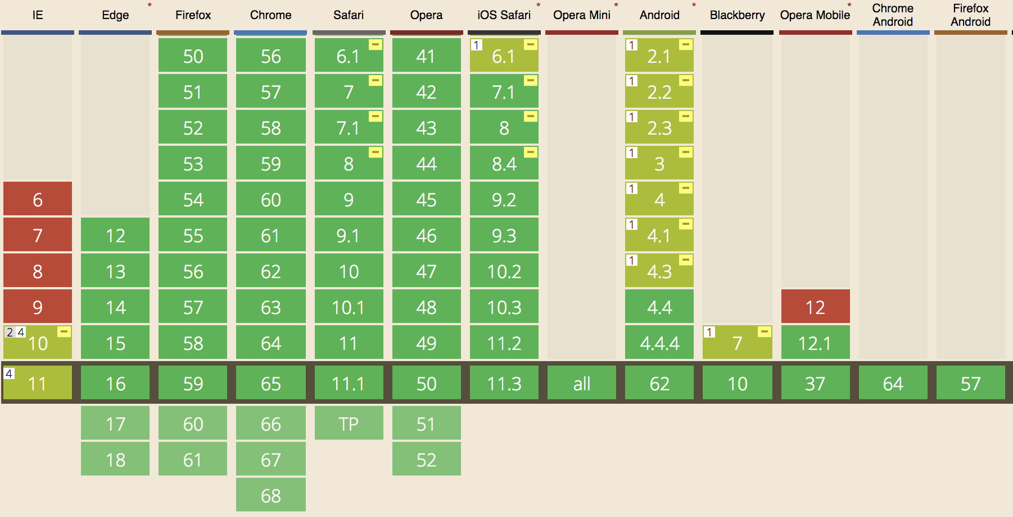
BROWSER SUPPORT
Notes:
1 Only supports the old flexbox specification and does not support wrapping.
2 Only supports the 2012 syntax
3 Does not support flex-wrap, flex-flow or align-content properties
4 Partial support is due to large amount of bugs present (see known issues)

Slide 41
examples

Slide 42
FLEXBOX IS IDEAL FOR COMPONENTS
Home
About
Services
Gallery
Contacts
Home
About
Help
Sign In
Sign Up
CSS
CSS
.navigation {
display: flex;
flex-flow: row nowrap;
}
. navigation .flex-item {
flex: 1 0 auto;
}
​
​
.container {
display: flex;
flex-flow: row nowrap;
}
.container .flex-item {
flex: 1 0 auto;
}
.sign-in { margin-left: auto;
}
Notes:
11
FLEXBOX IS IDEAL FOR COMPONENTS
Flexbox very suitable for the layout component / separate parts of the application / web pages, any components and small-scale layouts.
https://philipwalton.github.io/solved-by-flexbox/

Slide 43
TOOLS
1
Flexy Boxes
4
Flexbox help
http://the-echoplex.net/flexyboxes/
http://flexbox.help/
2
Flexplorer
5
Flexbox in 5 minutes
http://bennettfeely.com/flexplorer/
http://flexboxfroggy.com/
3
Flexbox Grid
6
CSS Flexbox Please!
http://flexboxgrid.com/
http://demo.agektmr.com/flexbox/
Notes:
TOOLS
1. Flexy Boxes http://the-echoplex.net/flexyboxes/
2. Flexplorer http://bennettfeely.com/flexplorer/
3. Flexbox Grid http://flexboxgrid.com/
4. Flexbox help http://flexbox.help/
5. Flexbox in 5 minutes http://flexboxin5.com/
6. CSS Flexbox Please! http://demo.agektmr.com/flexbox/

Slide 44
conclusion
Let’s make a sum up

Slide 45
WHAT’S SO GREAT ABOUT FLEXBOX?
It’s a new layout mode
Source order independence
Joins block, inline, table, and positioned
You want that before this, but only when that? Ok.
It’s flexible!
Any direction you want
You can easily make things stretch and flex to fit available space
You can set direction within containers
Easy alignment
Easy Syntax
Horizontal, vertical, baseline
You can learn it in one afternoon.
Establish flow direction
Flex containers can flow either in a row or column and be single or multiple
Notes:
WHAT’S SO GREAT ABOUT FLEXBOX?
It’s a new layout mode - Joins block, inline, table, and positioned
It’s flexible! - You can easily make things grow, shrink, stretch and flex to fit(fill in) available space (Give boxes proportional measurements. Make boxes automatically grow to fill space or shrink to avoid overflow. Elements can “flex” their size to respond to available space and align to their containers or other elements.)
Establish flow direction - Flex containers can flow either in a row or column occupying all provided the space.
Easy alignment - Horizontal, vertical, baseline… it’s all good (Align boxes on any side)
Source order independence - You want that before this, but only when that? Ok. (Place boxes out of order from HTML. Set a different display order can differ from source order in an HTML page.) You can manage it from CSS with the Flexbox. This is especially important for some aspects of the responsive layout.
Any direction you want - You can set direction within containers. (Layout boxes in any direction. Flow directions can be up or down, left or right, display order can be reversed.). Many languages in the world use rtl (right-to-left), as opposed to the usual we ltr (left-to-right). Flexbox adapted for this purpose. It is the concept of begin and end, but not the right and left. So that, in browsers with rtl all elements will be automatically arranged in reverse order.
Easy Syntax - The syntax of CSS is very simple and can be learned pretty quickly(You can learn it in one afternoon).

Slide 46
CSS
GRID
Layout

Slide 47
CSS GRID LAYOUT
mechanism to divide the available space in rows
and columns
defines a set of grid areas where to precisely place
elements of a web page
Notes:
CSS Grid Layout (aka "Grid"), is a two-dimensional grid-based layout system that aims to do nothing less than completely change the way we design grid-based user interfaces. CSS has always been used to lay out our web pages, but it's never done a very good job of it. First we used tables, then floats, positioning and inline-block, but all of these methods were essentially hacks and left out a lot of important functionality (vertical centering, for instance). Flexbox helped out, but it's intended for simpler one-dimensional layouts, not complex two-dimensional ones (Flexbox and Grid actually work very well together). Grid is the very first CSS module created specifically to solve the layout problems we've all been hacking our way around for as long as we've been making websites.

Slide 48
Grid Features
Overlapping
Content

Slide 49
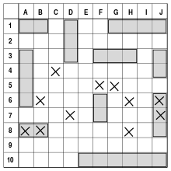
Grid features
PRECISE
LOCATION

Slide 50
Grid features
Control
Alignment

Slide 51
Components
Concepts & terminology

Slide 52
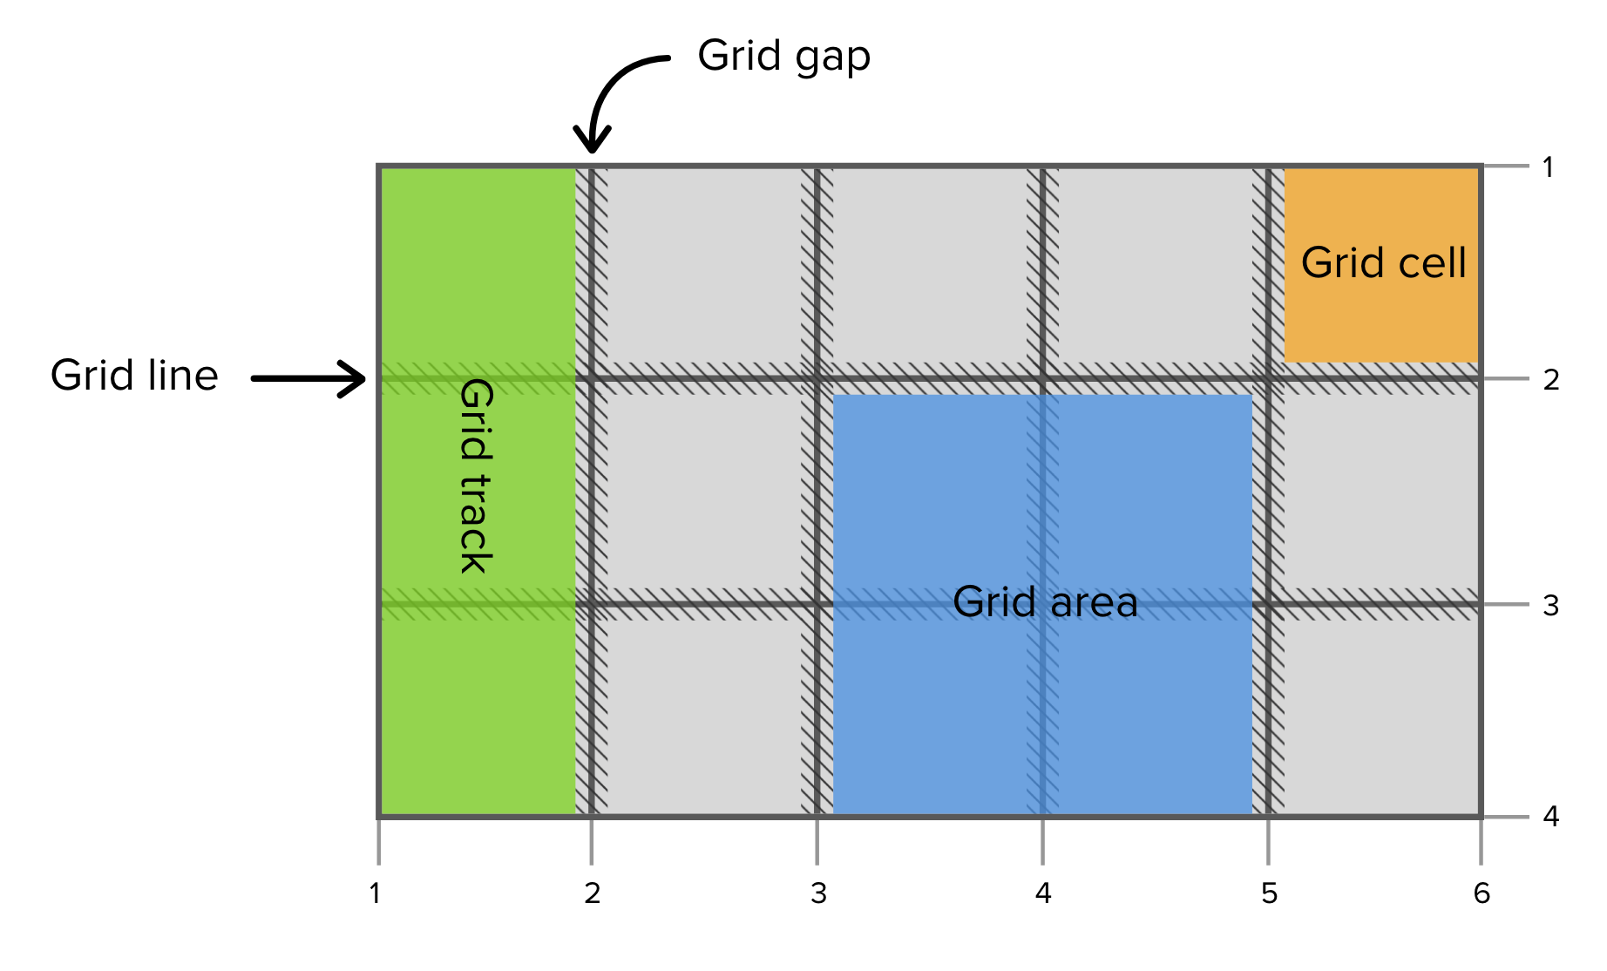
CONCEPTS AND TERMINOLOGY
Notes:
Grid lines are the horizontal and vertical lines that form the basis of the grid structure. They are used to position items on the grid. We can refer to them by numerical index, which starts at 1.
Grid lines also have negative indices, which allow us to reference grid lines starting from the end of the grid. One of the use cases for negative indices is if you need an item in the last column, regardless of number of tracks, then giving that item a grid-column-end property of -1 will handle it.
Grid Container
The element on which display: grid is applied. It's the direct parent of all the grid items. In this example container is the grid container.
Grid Item
The children (e.g. direct descendants) of the grid container. Here the item elements are grid items, but sub-item isn’t.
Grid Line
The dividing lines that make up the structure of the grid. They can be either vertical ("column grid lines") or horizontal ("row grid lines") and reside on either side of a row or column. Here the yellow line is an example of a column grid line.
Grid Track
The space between two adjacent grid lines. You can think of them like the columns or rows of the grid. Here's the grid track between the second and third row grid lines.
Grid Cell
The space between two adjacent row and two adjacent column grid lines. It's a single "unit" of the grid. Here's the grid cell between row grid lines 1 and 2, and column grid lines 2 and 3.
Grid Area
The total space surrounded by four grid lines. A grid area may be comprised of any number of grid cells. Here's the grid area between row grid lines 1 and 3, and column grid lines 1 and 3.

Slide 53
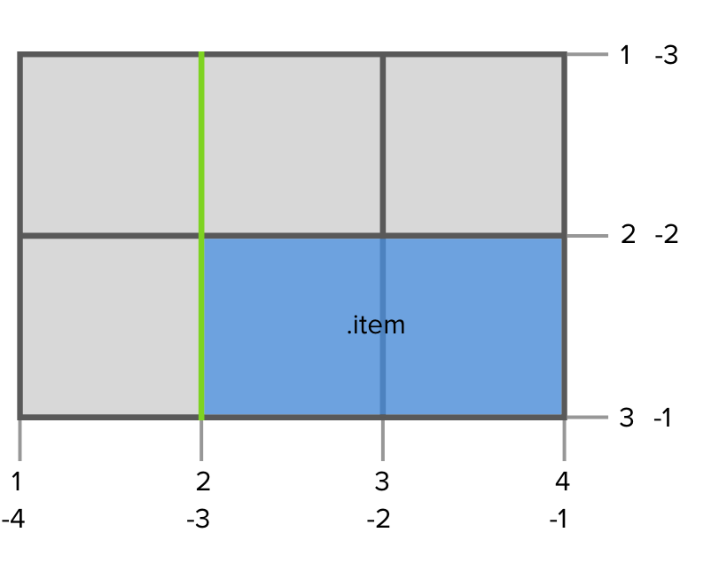
EXAMPLE
CSS
.grid-container {
display: grid;
grid-template-columns: 150px 150px 150px;
grid-template-rows: 150px 150px;
}
.item {
grid-column-start: 2;
grid-column-end: 4;
grid-row: 2 / 3;
}​
Notes:
The structure of the grid, like how many rows and columns it has and their sizing, is controlled by properties applied to the grid container. Placement of grid items is determined by CSS properties applied to the child elements inside the grid container.
A grid container is defined by setting the display to grid or inline-grid on an element. This creates a grid formatting context for its content, which are laid out into a grid. The grid formatting context only applies to child elements and does not extend to grandchild elements and beyond.
Grid lines are the horizontal and vertical lines that form the basis of the grid structure. They are used to position items on the grid. We can refer to them by numerical index, which starts at 1.
Grid lines also have negative indices, which allow us to reference grid lines starting from the end of the grid. One of the use cases for negative indices is if you need an item in the last column, regardless of number of tracks, then giving that item a grid-column-end property of -1 will handle it.
Grid Container
The element on which display: grid is applied. It's the direct parent of all the grid items. In this example container is the grid container.
Grid Item
The children (e.g. direct descendants) of the grid container. Here the item elements are grid items, but sub-item isn’t.
Grid Line
The dividing lines that make up the structure of the grid. They can be either vertical ("column grid lines") or horizontal ("row grid lines") and reside on either side of a row or column. Here the yellow line is an example of a column grid line.
Grid Track
The space between two adjacent grid lines. You can think of them like the columns or rows of the grid. Here's the grid track between the second and third row grid lines.
Grid Cell
The space between two adjacent row and two adjacent column grid lines. It's a single "unit" of the grid. Here's the grid cell between row grid lines 1 and 2, and column grid lines 2 and 3.
Grid Area
The total space surrounded by four grid lines. A grid area may be comprised of any number of grid cells. Here's the grid area between row grid lines 1 and 3, and column grid lines 1 and 3.

Slide 54
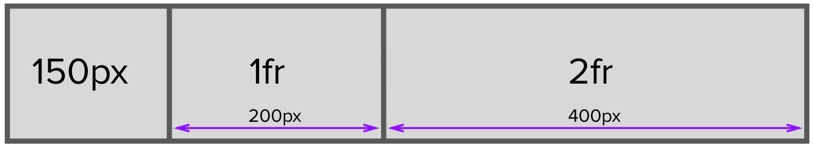
1 FR
fr unit takes up a share of the remaining free space in proportion to its flex factor.
CSS
.grid-container {
display: grid;
width: 750px;
grid-template-columns: 150px 1fr 2fr;
}
Notes:
The structure of the grid, like how many rows and columns it has and their sizing, is controlled by properties applied to the grid container. Placement of grid items is determined by CSS properties applied to the child elements inside the grid container.
A grid container is defined by setting the display to grid or inline-grid on an element. This creates a grid formatting context for its content, which are laid out into a grid. The grid formatting context only applies to child elements and does not extend to grandchild elements and beyond.
Grid lines are the horizontal and vertical lines that form the basis of the grid structure. They are used to position items on the grid. We can refer to them by numerical index, which starts at 1.
Grid lines also have negative indices, which allow us to reference grid lines starting from the end of the grid. One of the use cases for negative indices is if you need an item in the last column, regardless of number of tracks, then giving that item a grid-column-end property of -1 will handle it.
Grid Container
The element on which display: grid is applied. It's the direct parent of all the grid items. In this example container is the grid container.
Grid Item
The children (e.g. direct descendants) of the grid container. Here the item elements are grid items, but sub-item isn’t.
Grid Line
The dividing lines that make up the structure of the grid. They can be either vertical ("column grid lines") or horizontal ("row grid lines") and reside on either side of a row or column. Here the yellow line is an example of a column grid line.
Grid Track
The space between two adjacent grid lines. You can think of them like the columns or rows of the grid. Here's the grid track between the second and third row grid lines.
Grid Cell
The space between two adjacent row and two adjacent column grid lines. It's a single "unit" of the grid. Here's the grid cell between row grid lines 1 and 2, and column grid lines 2 and 3.
Grid Area
The total space surrounded by four grid lines. A grid area may be comprised of any number of grid cells. Here's the grid area between row grid lines 1 and 3, and column grid lines 1 and 3.

Slide 55
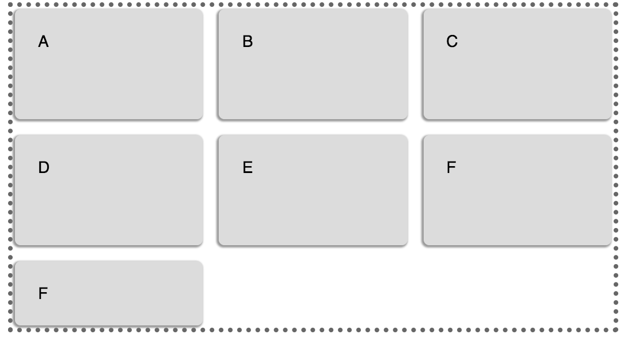
REPEAT
CSS
.grid-container {
display: grid;
grid-template-columns: repeat(3, 1fr);
grid-template-rows: 100px 100px;
grid-gap: 10px;
}
Notes:
The structure of the grid, like how many rows and columns it has and their sizing, is controlled by properties applied to the grid container. Placement of grid items is determined by CSS properties applied to the child elements inside the grid container.
A grid container is defined by setting the display to grid or inline-grid on an element. This creates a grid formatting context for its content, which are laid out into a grid. The grid formatting context only applies to child elements and does not extend to grandchild elements and beyond.
Grid lines are the horizontal and vertical lines that form the basis of the grid structure. They are used to position items on the grid. We can refer to them by numerical index, which starts at 1.
Grid lines also have negative indices, which allow us to reference grid lines starting from the end of the grid. One of the use cases for negative indices is if you need an item in the last column, regardless of number of tracks, then giving that item a grid-column-end property of -1 will handle it.
Grid Container
The element on which display: grid is applied. It's the direct parent of all the grid items. In this example container is the grid container.
Grid Item
The children (e.g. direct descendants) of the grid container. Here the item elements are grid items, but sub-item isn’t.
Grid Line
The dividing lines that make up the structure of the grid. They can be either vertical ("column grid lines") or horizontal ("row grid lines") and reside on either side of a row or column. Here the yellow line is an example of a column grid line.
Grid Track
The space between two adjacent grid lines. You can think of them like the columns or rows of the grid. Here's the grid track between the second and third row grid lines.
Grid Cell
The space between two adjacent row and two adjacent column grid lines. It's a single "unit" of the grid. Here's the grid cell between row grid lines 1 and 2, and column grid lines 2 and 3.
Grid Area
The total space surrounded by four grid lines. A grid area may be comprised of any number of grid cells. Here's the grid area between row grid lines 1 and 3, and column grid lines 1 and 3.

Slide 56
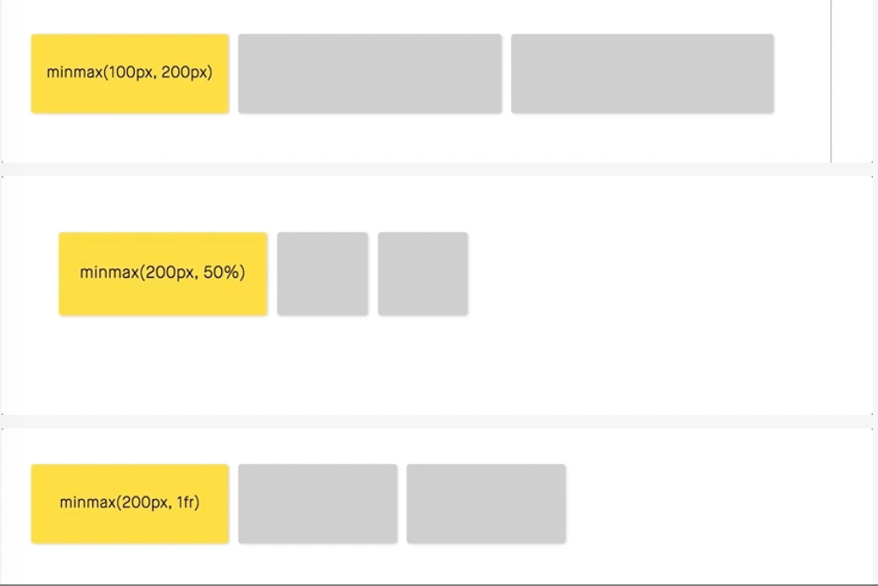
MINMAX
CSS
.grid-container {
display: grid;
grid-template-columns:
minmax(200px, 1fr) 1fr 1fr;
}
Notes:
The structure of the grid, like how many rows and columns it has and their sizing, is controlled by properties applied to the grid container. Placement of grid items is determined by CSS properties applied to the child elements inside the grid container.
A grid container is defined by setting the display to grid or inline-grid on an element. This creates a grid formatting context for its content, which are laid out into a grid. The grid formatting context only applies to child elements and does not extend to grandchild elements and beyond.
Grid lines are the horizontal and vertical lines that form the basis of the grid structure. They are used to position items on the grid. We can refer to them by numerical index, which starts at 1.
Grid lines also have negative indices, which allow us to reference grid lines starting from the end of the grid. One of the use cases for negative indices is if you need an item in the last column, regardless of number of tracks, then giving that item a grid-column-end property of -1 will handle it.
Grid Container
The element on which display: grid is applied. It's the direct parent of all the grid items. In this example container is the grid container.
Grid Item
The children (e.g. direct descendants) of the grid container. Here the item elements are grid items, but sub-item isn’t.
Grid Line
The dividing lines that make up the structure of the grid. They can be either vertical ("column grid lines") or horizontal ("row grid lines") and reside on either side of a row or column. Here the yellow line is an example of a column grid line.
Grid Track
The space between two adjacent grid lines. You can think of them like the columns or rows of the grid. Here's the grid track between the second and third row grid lines.
Grid Cell
The space between two adjacent row and two adjacent column grid lines. It's a single "unit" of the grid. Here's the grid cell between row grid lines 1 and 2, and column grid lines 2 and 3.
Grid Area
The total space surrounded by four grid lines. A grid area may be comprised of any number of grid cells. Here's the grid area between row grid lines 1 and 3, and column grid lines 1 and 3.

Slide 57
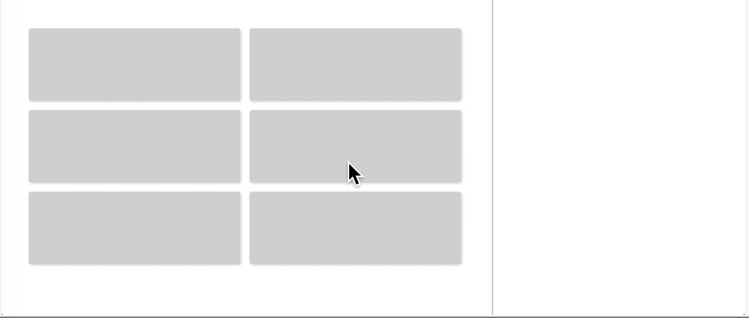
RWD WITHOUT MEDIA QUERY
CSS
.grid-container {
display: grid;
grid-template-columns: repeat(auto-fit, minmax(200px, 1fr));
}
Notes:
auto-fit: This keyword can be used with the repeat() function instead a number of times to repeat. This will flexibly change the number of columns that are used based on the width each column can be.
The auto-fill keyword will generate as many columns as will fit the available space without causing the grid to overflow, and the auto-fit keyword behaves similarly.
The structure of the grid, like how many rows and columns it has and their sizing, is controlled by properties applied to the grid container. Placement of grid items is determined by CSS properties applied to the child elements inside the grid container.
A grid container is defined by setting the display to grid or inline-grid on an element. This creates a grid formatting context for its content, which are laid out into a grid. The grid formatting context only applies to child elements and does not extend to grandchild elements and beyond.
Grid lines are the horizontal and vertical lines that form the basis of the grid structure. They are used to position items on the grid. We can refer to them by numerical index, which starts at 1.
Grid lines also have negative indices, which allow us to reference grid lines starting from the end of the grid. One of the use cases for negative indices is if you need an item in the last column, regardless of number of tracks, then giving that item a grid-column-end property of -1 will handle it.
Grid Container
The element on which display: grid is applied. It's the direct parent of all the grid items. In this example container is the grid container.
Grid Item
The children (e.g. direct descendants) of the grid container. Here the item elements are grid items, but sub-item isn’t.
Grid Line
The dividing lines that make up the structure of the grid. They can be either vertical ("column grid lines") or horizontal ("row grid lines") and reside on either side of a row or column. Here the yellow line is an example of a column grid line.
Grid Track
The space between two adjacent grid lines. You can think of them like the columns or rows of the grid. Here's the grid track between the second and third row grid lines.
Grid Cell
The space between two adjacent row and two adjacent column grid lines. It's a single "unit" of the grid. Here's the grid cell between row grid lines 1 and 2, and column grid lines 2 and 3.
Grid Area
The total space surrounded by four grid lines. A grid area may be comprised of any number of grid cells. Here's the grid area between row grid lines 1 and 3, and column grid lines 1 and 3.

Slide 58
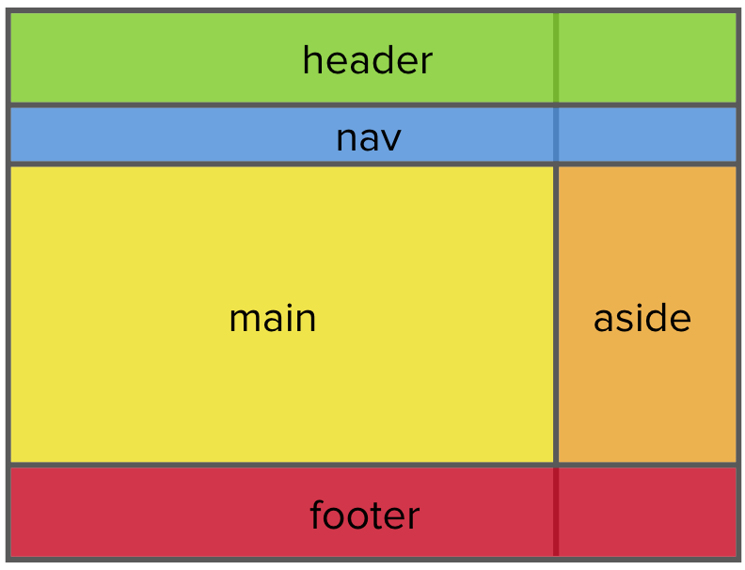
GRID-TEMPLATE-AREAS, PLACING ITEMS IN THE GRID
CSS
body {
display: grid;
grid-template-areas: "header header"
"nav nav"
"content sidebar"
"footer footer";
grid-template-columns: 1fr 25%;
}
header { grid-area: header; }
nav { grid-area: nav; }
footer { grid-area: footer; }
main { grid-area: content;}
aside { grid-area: sidebar; }
Notes:
auto-fit: This keyword can be used with the repeat() function instead a number of times to repeat. This will flexibly change the number of columns that are used based on the width each column can be.
The auto-fill keyword will generate as many columns as will fit the available space without causing the grid to overflow, and the auto-fit keyword behaves similarly.
The structure of the grid, like how many rows and columns it has and their sizing, is controlled by properties applied to the grid container. Placement of grid items is determined by CSS properties applied to the child elements inside the grid container.
A grid container is defined by setting the display to grid or inline-grid on an element. This creates a grid formatting context for its content, which are laid out into a grid. The grid formatting context only applies to child elements and does not extend to grandchild elements and beyond.
Grid lines are the horizontal and vertical lines that form the basis of the grid structure. They are used to position items on the grid. We can refer to them by numerical index, which starts at 1.
Grid lines also have negative indices, which allow us to reference grid lines starting from the end of the grid. One of the use cases for negative indices is if you need an item in the last column, regardless of number of tracks, then giving that item a grid-column-end property of -1 will handle it.
Grid Container
The element on which display: grid is applied. It's the direct parent of all the grid items. In this example container is the grid container.
Grid Item
The children (e.g. direct descendants) of the grid container. Here the item elements are grid items, but sub-item isn’t.
Grid Line
The dividing lines that make up the structure of the grid. They can be either vertical ("column grid lines") or horizontal ("row grid lines") and reside on either side of a row or column. Here the yellow line is an example of a column grid line.
Grid Track
The space between two adjacent grid lines. You can think of them like the columns or rows of the grid. Here's the grid track between the second and third row grid lines.
Grid Cell
The space between two adjacent row and two adjacent column grid lines. It's a single "unit" of the grid. Here's the grid cell between row grid lines 1 and 2, and column grid lines 2 and 3.
Grid Area
The total space surrounded by four grid lines. A grid area may be comprised of any number of grid cells. Here's the grid area between row grid lines 1 and 3, and column grid lines 1 and 3.

Slide 59
conclusion
Let’s make a sum up

Slide 60
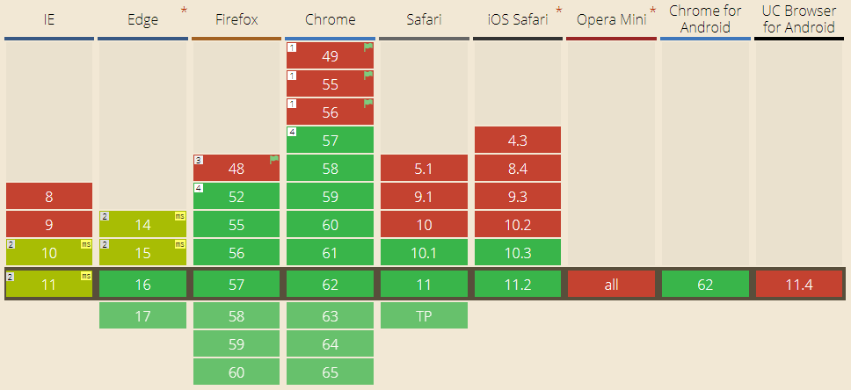
BROWSER SUPPORT
Notes:
Enabled in Chrome through the "experimental Web Platform features" flag in chrome://flags
2 Partial support in IE refers to supporting an older version of the specification.
3 Enabled in Firefox through the layout.css.grid.enabled flag
4 There are some bugs with overflow (1356820, 1348857, 1350925)

Slide 61
CSS Grid introduces a series of properties that allow us to create grid structures and control the placement and sizing of grid items using CSS.
SUCCESS

Slide 62
RESOURCES
Notes:
RESOURCES
Articles:
Flexbox:
Spec (http://www.w3.org/TR/css3-flexbox/) + The latest spec (http://dev.w3.org/csswg/css-flexbox/) Complete guide to Flexbox https://css-tricks.com/snippets/css/a-guide-to-flexbox/
Smashing Magazine tutorial (http://www.smashingmagazine.com/2013/05/22/centering-elements-with-flexbox/)
CSS3 Flexible Box Layout Explained (http://www.smashingmagazine.com/2011/09/19/css3-flexible-box-layout-explained/) Set up a frog onto a leaf http://flexboxfroggy.com/
Grid:
https://www.smashingmagazine.com/2017/11/css-grid-supporting-browsers-without-grid/
https://css-tricks.com/snippets/css/complete-guide-grid/
https://drafts.csswg.org/css-grid/
http://www.slideshare.net/rachelandrew/css-day-css-grid-layout
http://gridbyexample.com/ Grow your own garden with Grid layout http://cssgridgarden.com/
Tools:
CSS3 Flexplorer (http://bennettfeely.com/flexplorer/)
Flexbox playground and code generator (http://the-echoplex.net/flexyboxes/)
Flexbox in 5 minutes (http://devbryce.com/site/flexbox/)
CSS Flexbox Please! (http://demo.agektmr.com/flexbox/)
Debugging: https://github.com/philipwalton/flexbugs
Video:
https://vimeo.com/67011034
flex-box demo
1) flex-direction http://jsfiddle.net/alexriz/Lrt66psw/ direction: rtl;
2) flex-wrap http://jsfiddle.net/alexriz/q6hzry2k/
3) justify-content http://jsfiddle.net/alexriz/Lp1me1oh/
4) align-items and align-content http://jsfiddle.net/alexriz/on7km4mb/
5) order http://jsfiddle.net/alexriz/9evasnq9/
6) grow and shrink and basis http://madebymike.com.au/demos/flexbox-tester/
http://codepen.io/anon/pen/CmueD // Min-height and flexbox (flex-direction:column) don't work together in IE 10 & 11-preview.
http://chriswrightdesign.com/experiments/using-flexbox-today/
https://alastairc.ac/2014/08/flexbox-ie11-bugs/

Slide 63
ANY QUESTIONS ?
WHAT
WHY
WHERE
WHEN
WHO
HOW

Slide 64

Get in Touch
Anastasiia Skorobohata
Junior Software Engineer
Anastasiia_Skorobohata@epam.com

Slide 65
THANKS FOR ATTENTION!

